Slide 1
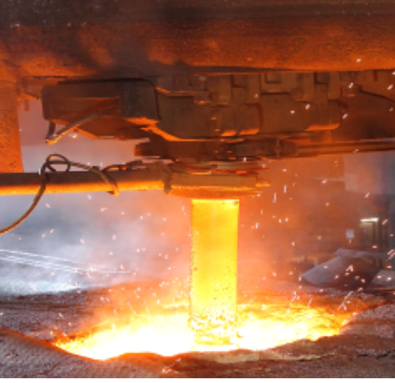
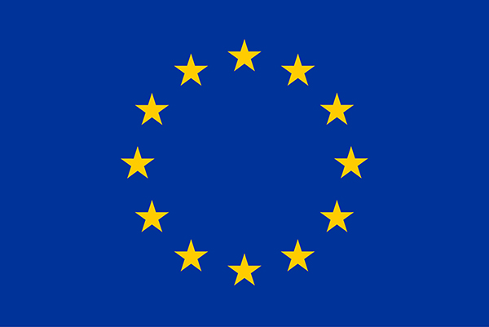
COMPUTATIONAL IMPLEMENTATION AND VALIDATION OF THE CONSTITUTIVE MODELS FOR HEAT RESISTANT DEVICES
Jovana Stojić, Massimo Penasa
This project has received funding from the European Union’s Horizon 2020 research and innovation programme under the Marie Skłodowska-Curie grant agreement No 955944 – RE-FRACTURE2.
This project has received funding from the European Union’s Horizon 2020 research and innovation programme under the Marie Skłodowska-Curie grant agreement No 955944 – RE-FRACTURE2.
This project has received funding from the European Union’s Horizon 2020 research and innovation programme under the Marie Skłodowska-Curie grant agreement No 955944 – RE-FRACTURE2.
This project has received funding from the European Union’s Horizon 2020 research and innovation programme under the Marie Skłodowska-Curie grant agreement No 955944 – RE-FRACTURE2.
This project has received funding from the European Union’s Horizon 2020 research and innovation programme under the Marie Skłodowska-Curie grant agreement No 955944 – RE-FRACTURE2.
This project has received funding from the European Union’s Horizon 2020 research and innovation programme under the Marie Skłodowska-Curie grant agreement No 955944 – RE-FRACTURE2.
This project has received funding from the European Union’s Horizon 2020 research and innovation programme under the Marie Skłodowska-Curie grant agreement No 955944 – RE-FRACTURE2.

Slide 2
TABLE OF CONTENTS
Introduction
Motivation
Basic information about the project and myself
01
02
Illustration of the problem regarding the analysis for the heat resistant device
Results
Future steps
Outcome of the analysis and their validation
Goals and intentions regarding the topic
03
04

Slide 3
RE-FRACTURE2
Reducing the ecological footprint of the steel production
Simulating the behavior of the refractories over the entire working temperature range
Characterisation of the material model and implementation in the routines for finite elements computations

Slide 4
MOTIVATION
Why refractories?
possess high thermal strength at elevated temperatures → widely used in steel and iron production
Wide working temperature range → fractures, thermal shock
Demand for the new refractory parts→ higher emission of CO2
Varying material properties dependent on the temperature → complex behavior

Slide 5
ABOUT THE MODEL
Nonlinear thermomechanical analysis of a heat resistant device including:
Nonlinear surface flux (temperature, coordinates and time dependent)
Temperature dependent material properties
Submerging (molten steel)

Slide 6
INCOUNTERED PROBLEMS
01
02
Custom subroutine for the heat flux
Python programming
High level of dependency

Slide 7
STEP BY STEP
01
Nonlinear thermal analysis (only varying parameters)
02
Nonlinear thermal + linear mechanical analysis
03
Translation of the subroutine
04
Adaption of the commands using Python
05
Nonlinear thermomechanical analysis

Slide 8
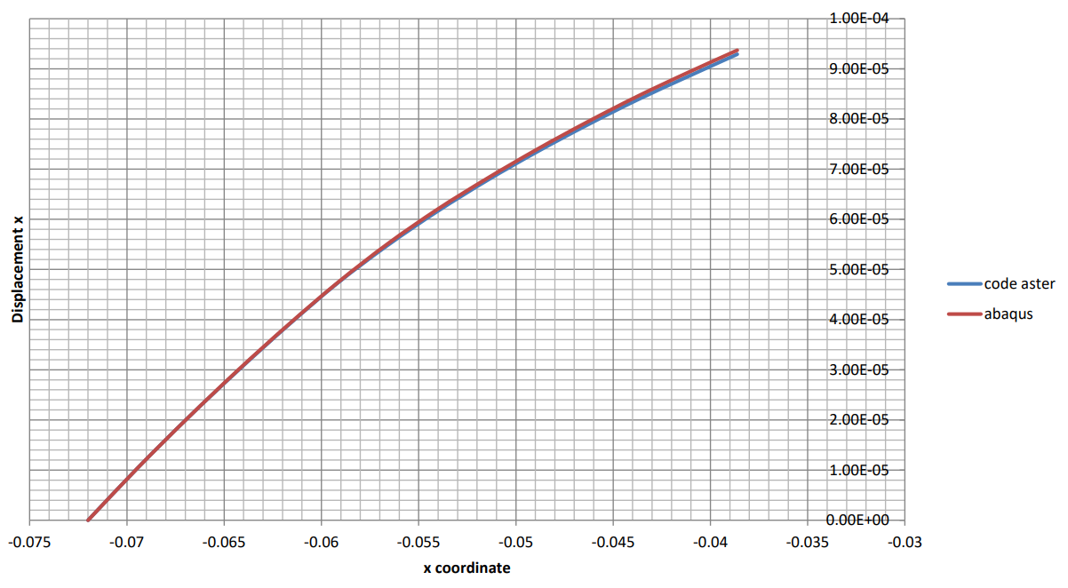
RESULTS COMPARISON
original
our results

Slide 9
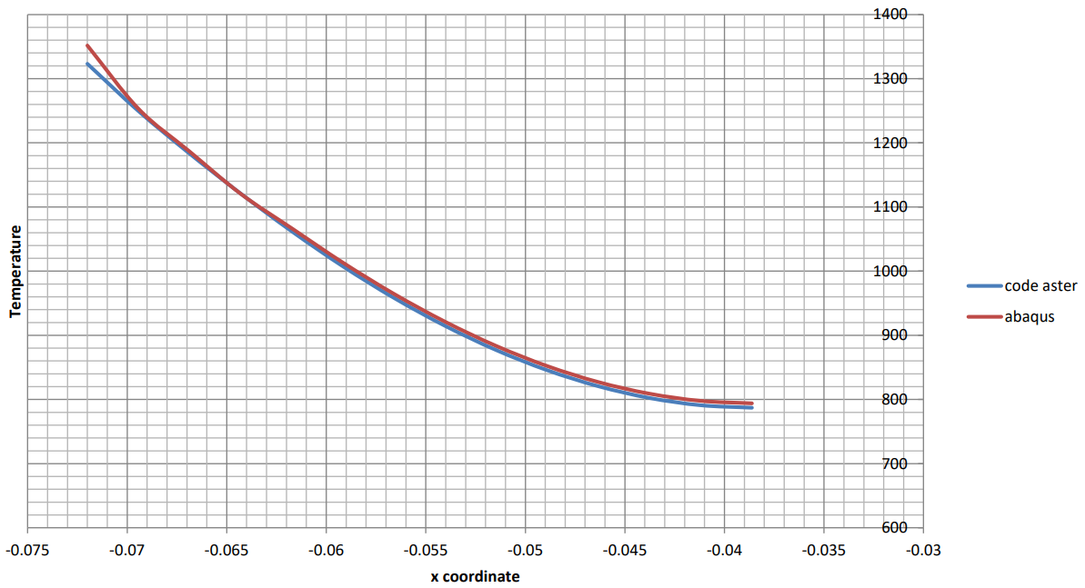
RESULTS COMPARISON
original
our results

Slide 10
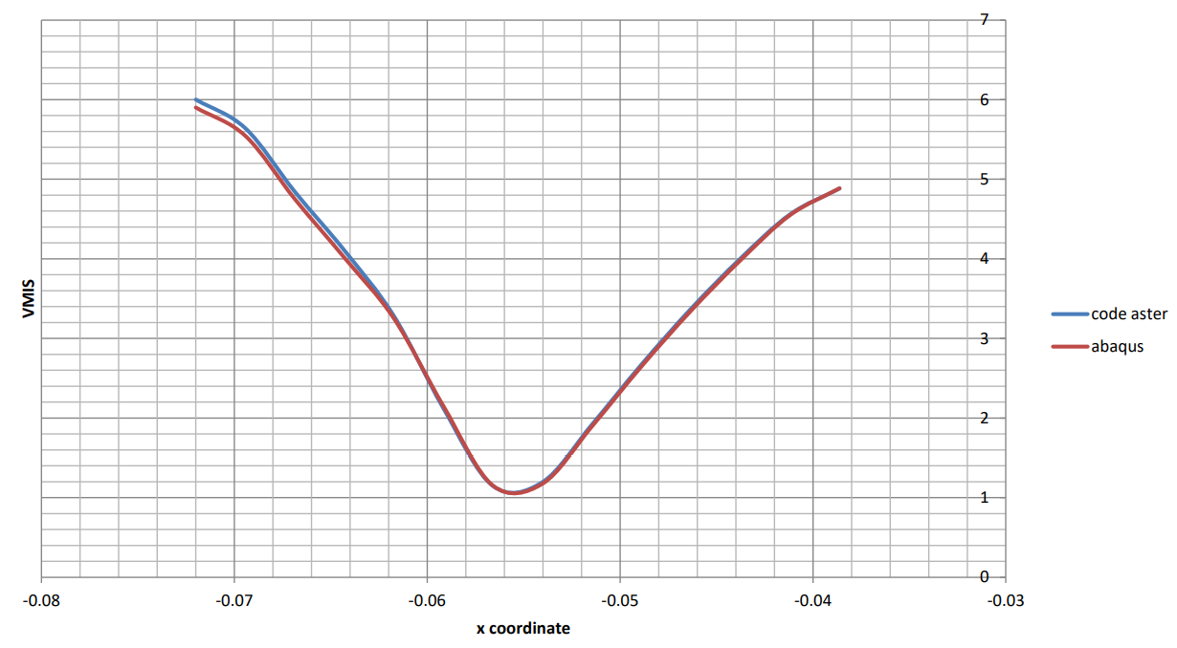
RESULTS COMPARISON
original
our results

Slide 11
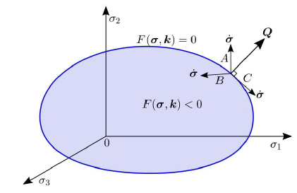
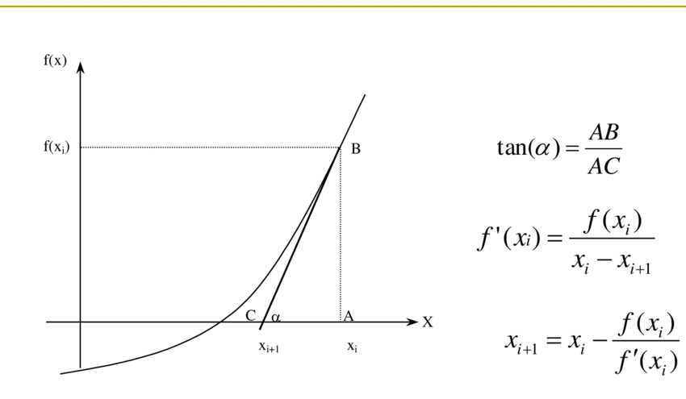
PLASTICITY MODEL
Decomposition of the strain tensor
ε$={\text{ε}}_{e}+ {\text{ε}}_{p}$
Flow rule
$$\dot{\text{ε}} =\dot{\text{λ}}Q$$
$$Q=\frac{∂f}{∂σ}$$
Yield function
$$F\left(σ, λ\right)=q − σ_{y}(λ)$$
Complementarity conditions
$$F≤0, \dot{λ}≥0, \dot{λ}F=0$$
F(σ, k) = 0
F(σ, k) < 0
p
Numerical method (Newton’s tangent)

Slide 12
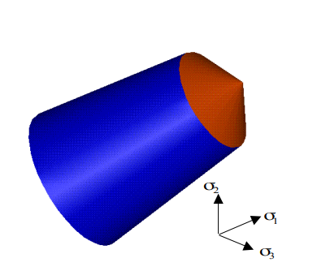
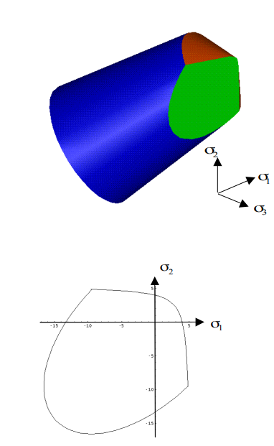
PLASTICITY MODEL – DOUBLE DRUCKER PRAGER
Yield function
$$f_{c}\left(σ, A_{c}\right)=\frac{τ_{oct}+aσ_{oct}}{b}−φ{f_{c}}_{}^{′}+A_{c}≤0$$
$$f_{t}\left(σ, A_{c}\right)=\frac{τ_{oct}+cσ_{oct}}{d}−{f_{t}}_{}^{′}+A_{t}≤0$$
$${f_{c}}^{H}\left(σ, A_{c}\right)=\frac{aσ_{oct}}{b}−φ{f_{c}}_{}^{′}+A_{c}≤0$$
$${f_{t}}^{H}\left(σ, A_{c}\right)=\frac{cσ_{oct}}{d}−{f_{t}}_{}^{′}+A_{t}≤0$$
$σ_{oct}=\frac{I_{1}}{3}=\frac{trace(σ)}{3}$
$$τ_{oct}=\sqrt{\frac{2}{3}J_{2}}=\sqrt{\frac{trace({σ_{dev}}^{2})}{3}}$$
Different characteristics in tension and compression
Double Drucker Prager cone, whose top is on the hydrostatical axis

Slide 13
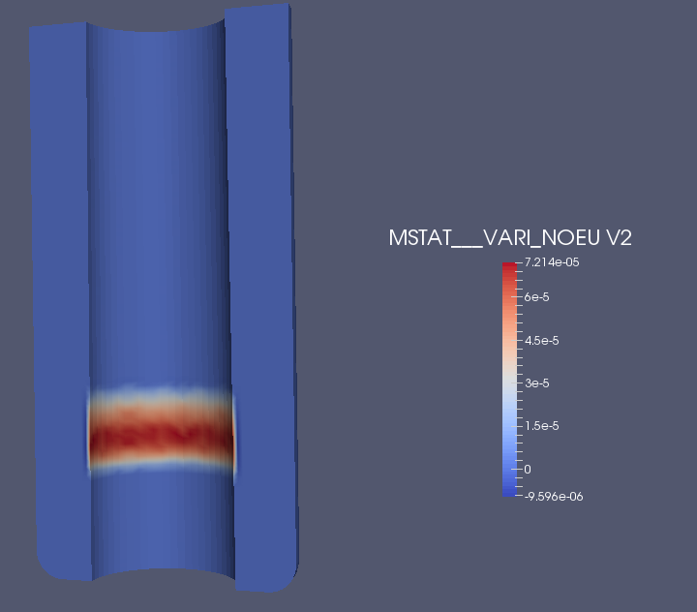
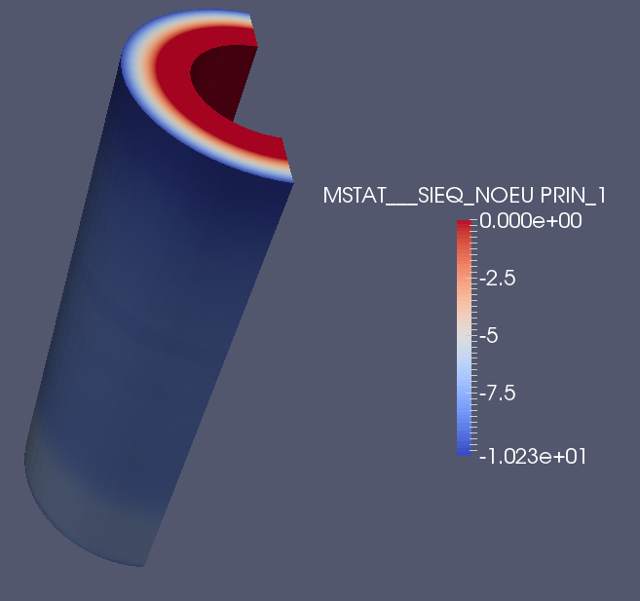
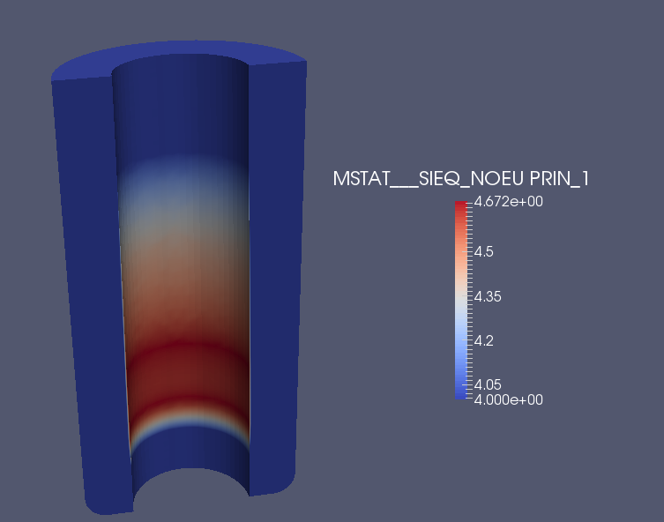
PLASTICITY MODEL – RESULTS
Stress and plastic strain distribution
Focus on the parts under tension developed because of the expansion of the outside of the tube
Compression
Tension

Slide 14
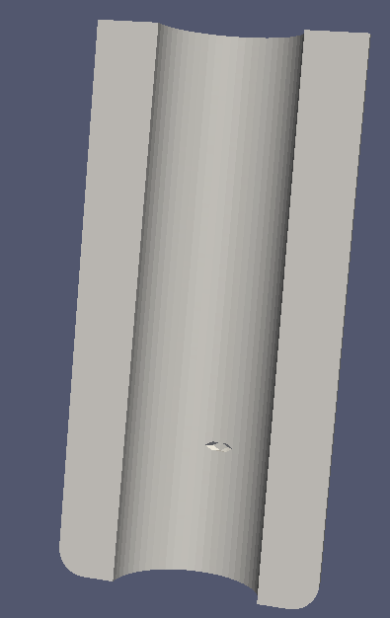
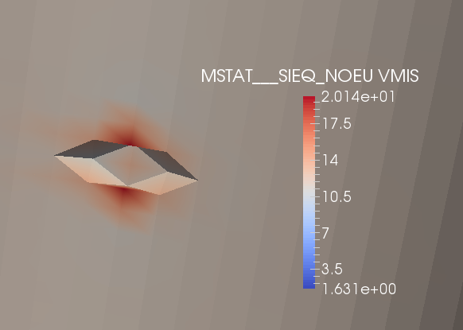
CASE STUDY- INITIAL CRACK
Initiated crack
Nonlinear thermomechanical analysis using Mazar's damage model
Potential collapse indication

Slide 15
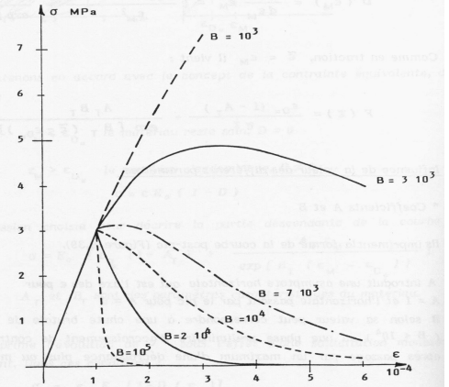
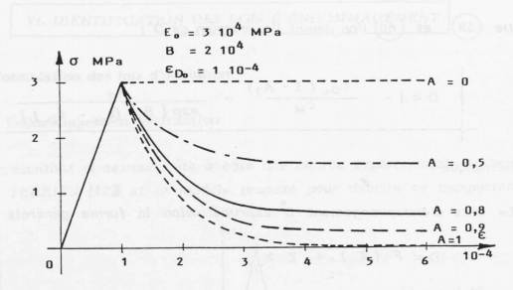
DAMAGE MODEL - MAZARS
Plasticity does not modify the elastic response of the material
Quasi-brittle - instead of the formation of one or few large cracks, the fracture failure is preceded by an elevated number of microcracks → introducing internal variables
Stress beyond the elastic limit→ inelastic deformation
Damage initiation criterion (deformation where damage starts) and a damage evolution criterion
The stress will still continue to grow for increasing values of strain, even if at a decreasing rate
Once the material reaches its peak stress (at some moderate value of the damage variable), the stress will start to decrease and follow its softening curve
Further damage can occur only if the strain reaches the maximum strain value measured in the previous load history
Bringing the peak stress closer to the damage initiation value that could be followed by a first rapid degradation while preserving the required energy dissipation for subsequent degradation at higher deformation levels
$$σ=\left(1 −D\right)Eε^{e}$$
E - the material matrix
D - damage internal variable
$ε^{e}$ - elastic strain

Slide 16
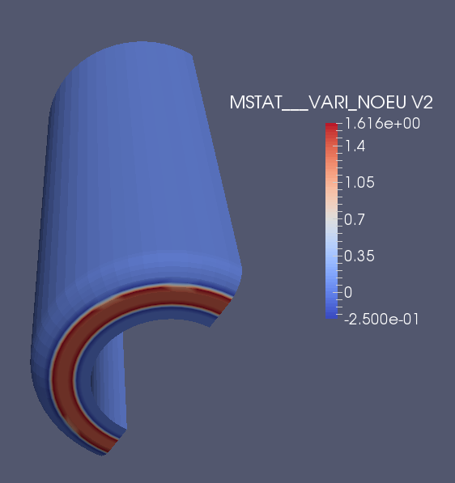
DAMAGE MODEL - RESULTS
Internal variable indicating damage

Slide 17
FUTURE PLANS
Acquiring the most suitable model for the refractory materials, accounting for different kind of nonlinearities
Validation of the models using mathematical programming
Extension of the FE software to allow the description of the thermoplastic instabilities
Fortran implementation of the constitutive model

Slide 18
THANK YOU FOR YOUR ATTENTION!
E-mail: stojic.jovana98@gmail.com
LinkedIn: Jovana Stojić
CAEmate
Sites: https://caemate.com
https://www.refracture2-h2020.eu
This project has received funding from the European Union’s Horizon 2020 research and innovation programme under the Marie Skłodowska-Curie grant agreement No 955944 – RE-FRACTURE2.

