Slide 1
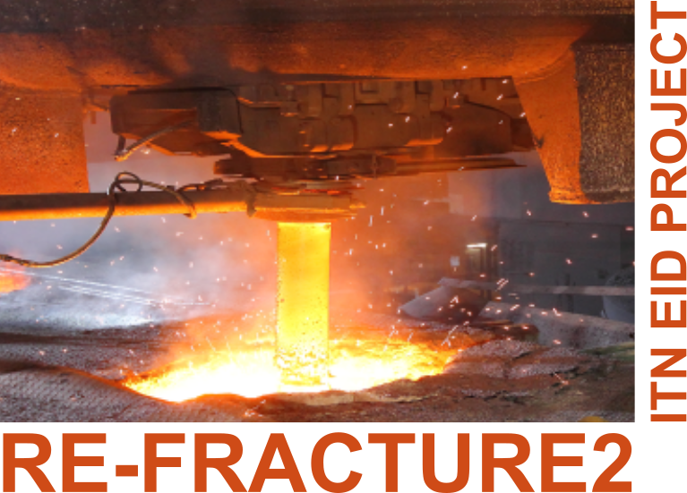
Advanced ceramics and application conference X
Serbian Ceramic Society
“Digital image correlation and inverse analysis for characterization of fracture properties”
Ilias Psilakis & Vladimir Buljak
This project has received funding from the European Union’s Horizon 2020 research and innovation programme under the Marie Sklodowska-Curie grant agreement No 955944 - RE-FRACTURE2.

Slide 2
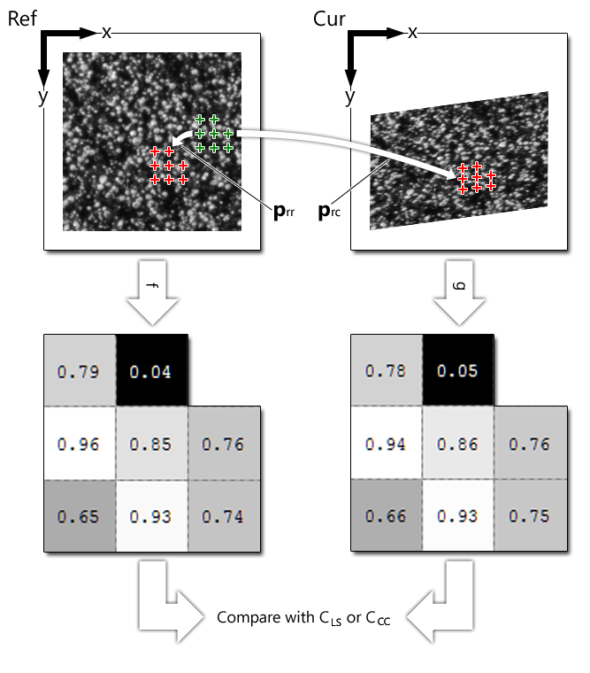
Digital Image Correlation | Inverse Analysis | Case study | Results | Next Steps | Conclusion
f_{m} and g_{m} are the mean grayscale values!
C_{LS} → 0 – Better match
2

Slide 3
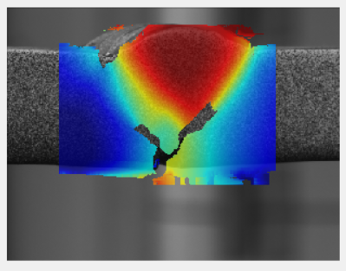
Digital Image Correlation | Inverse Analysis | Case study | Results | Next Steps | Conclusion
DIC is a valuable tool on planar surfaces where a suitable pattern is present or can be applied.
3

Slide 4
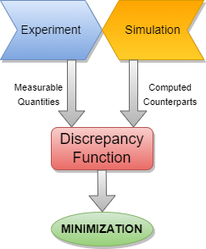
Inverse Analysis Procedure
Digital Image Correlation | Inverse Analysis | Case study | Results | Next Steps | Conclusion
Parameters identification (experiment selection)
Numerical model (FEM simulation)
Sensitivity analysis (measurable quantities – variation of parameters)
Objective function → Minimization
4

Slide 5
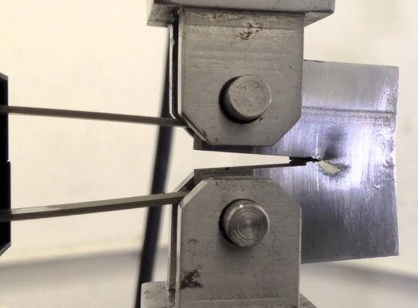
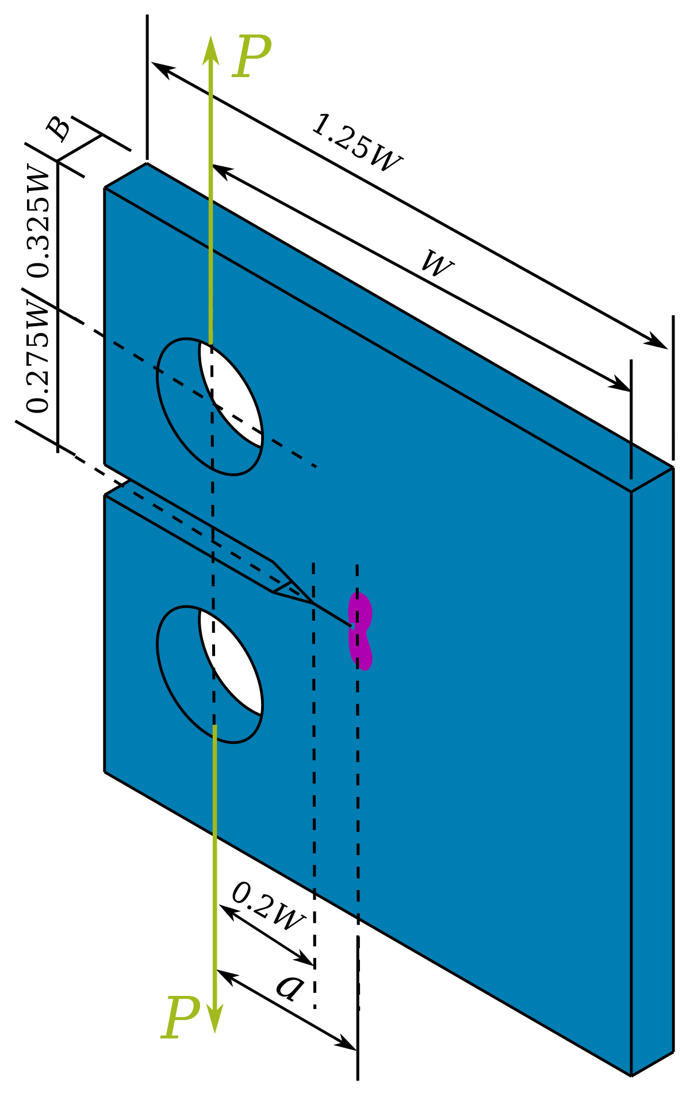
Compact Tension Specimen
Digital Image Correlation | Inverse Analysis | Case Study | Results | Next Steps | Conclusion
5

Slide 6
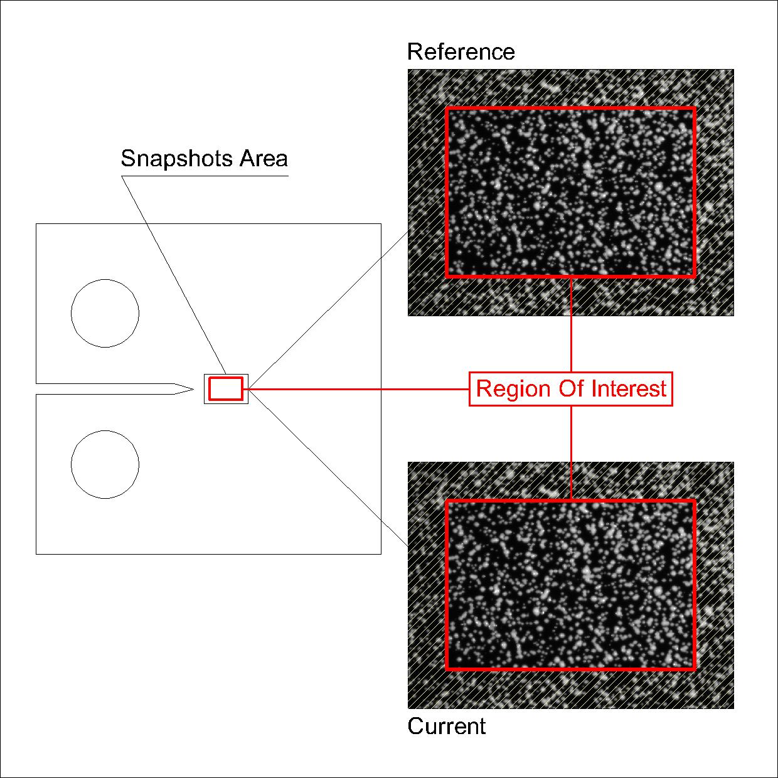
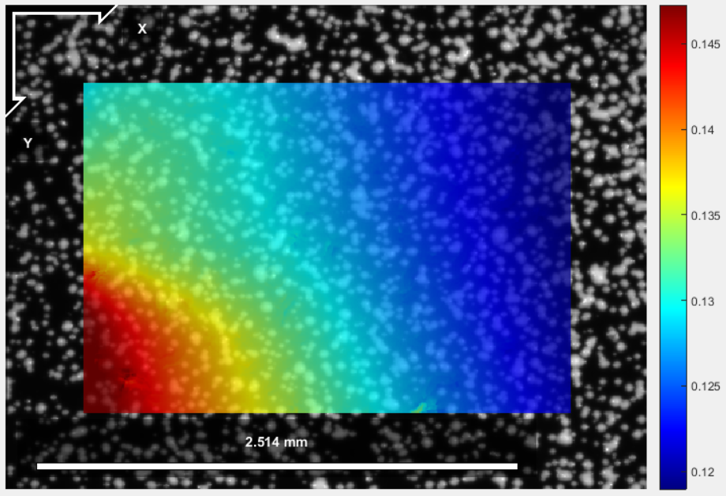
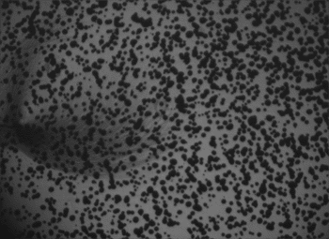
Digital Image Correlation | Inverse Analysis | Case Study | Results | Next Steps | Conclusion
6

Slide 7
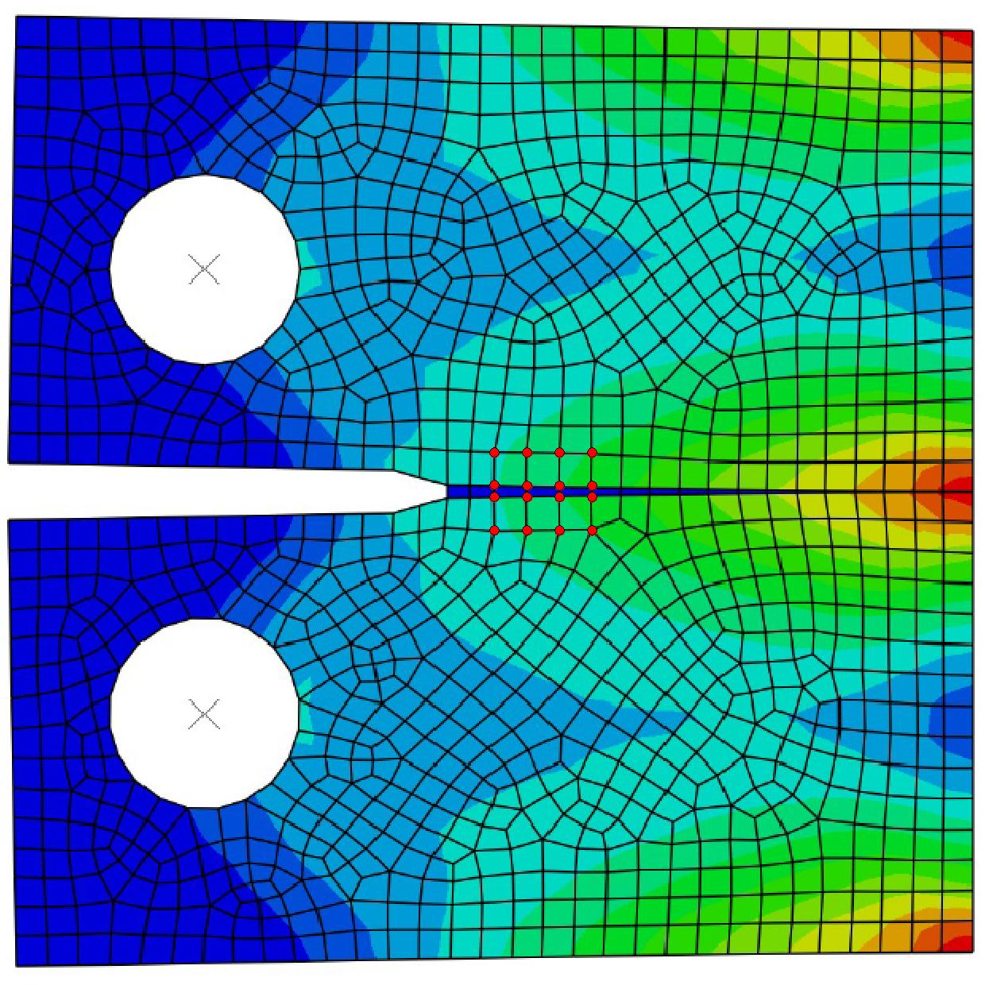
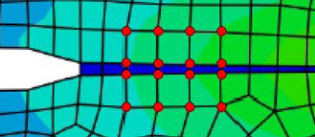
The numerical model
Digital Image Correlation | Inverse Analysis | Case Study | Results | Next Steps | Conclusion
Elasticity Model
Zero thickness cohesive elements
Damage Criterion
Region Of Interest!
(stress distribution)
7

Slide 8
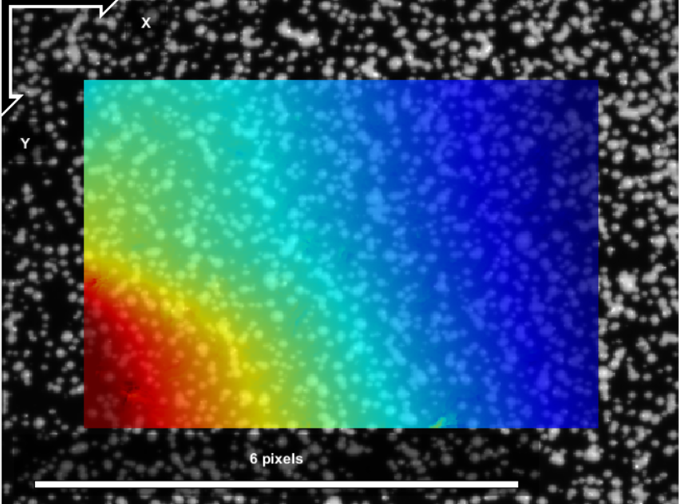
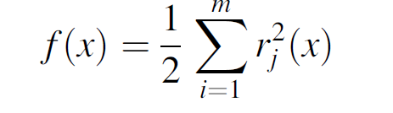
Digital Image Correlation | Inverse Analysis | Case Study | Results | Next Steps | Conclusion
Discrepancy Function (i.e. objective function)
ω =f |Uexp – Ucom(x)|=f |r|
Parameters
Objective Function
1) Young Modulus 2) Damage Initiation
Optimization Algorithm
Nonlinear Least Squares (NLS)
8

Slide 9
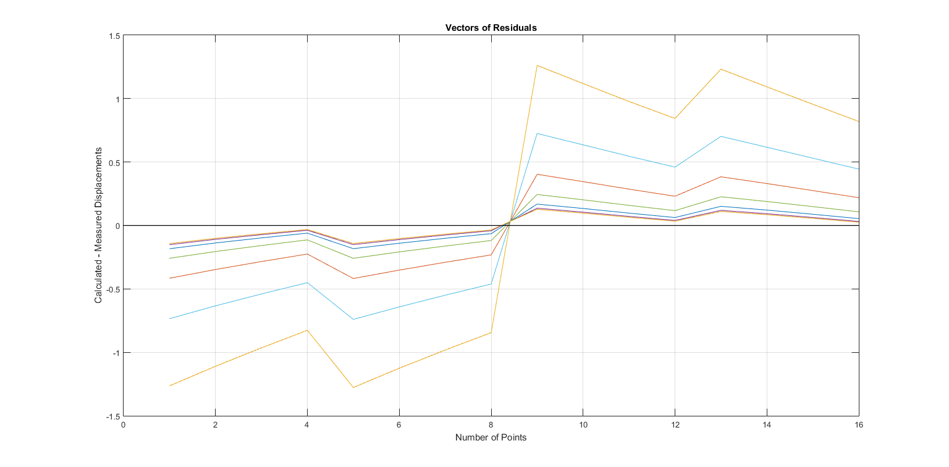
Digital Image Correlation | Inverse Analysis | Case study | Results | Next Steps | Conclusion
9

Slide 10
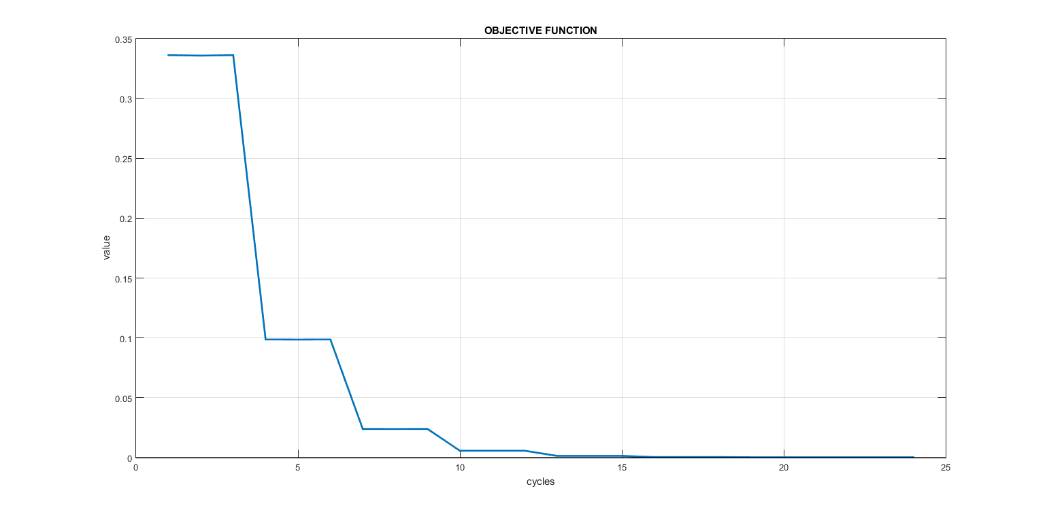
Digital Image Correlation | Inverse Analysis | Case study | Results | Next Steps | Conclusion
10

Slide 11
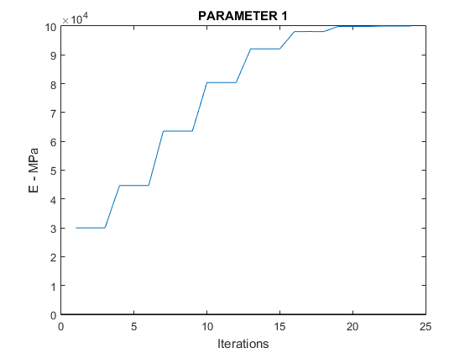
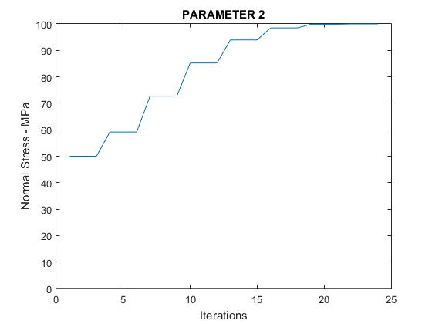
Digital Image Correlation | Inverse Analysis | Case study | Results | Next Steps | Conclusion
11

Slide 12
Digital Image Correlation | Inverse Analysis | Case study | Results | Next Steps | Conclusion
To build more complex models
More parameters
12

Slide 13
Digital Image Correlation | Inverse Analysis | Case study | Results | Next Steps | Conclusion
DIC
IA
GENERATING RESULTS – HANDLING DATA WITH MISSING INFORMATION
13

Slide 14
Advanced ceramics and application conference X
Serbian Ceramic Society
Thank you for your attention!
Ilias Psilakis
ipsilakis@mas.bg.ac.rs
This project has received funding from the European Union’s Horizon 2020 research and innovation programme under the Marie Sklodowska-Curie grant agreement No 955944 - RE-FRACTURE2.

