Slide 1



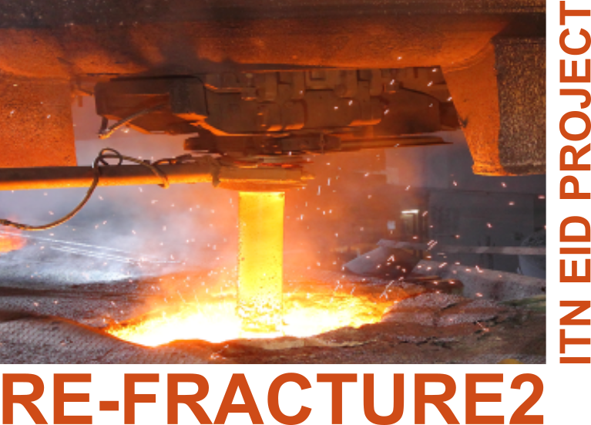

Advanced ceramics and application conference X
Serbian Ceramic Society, Belgrade
“Algorithm for automatic insertion of cohesive elements for simulation of brittle materials”
Domagoj Uremović and Vladimir Buljak
This project has received funding from the European Union’s Horizon 2020 research and innovation programme under the Marie Sklodowska-Curie grant agreement No 955944 - RE-FRACTURE2.
Notes:
Good morning everyone and welcome to my presentation. First of all, let me thank you all for listening my presentation today.
.
Let me start by introducing myself. I’m Domagoj Uremović, I’m a PhD student of Faculty of Mechanical engineering University of Belgrade and I would like to present a piece of my work today that I’ve been working on past several months.
.
Today’s topic is Algorithm for automatic insertion of cohesive elements for simulation of brittle materials. So, let’s dive in.
This project is a part of a larger group project REFRACTURE 2 under European Union's Horizon 2020 programme under MSC from where I would like to acknowledge the funds.
Još pripreme!!
Skratiti!! Ostaviti minutu 2 za diskusiju - znači 13 min max priče
Max 5 minuta za intro
Trčim s vremenom takav se dojam dobija …neke “dramske pauze”
Više spremanja - početak je bolje uvjezban nego kraj
Zbog vremenskih okvira - da se izbjegne bolje uvjezban pocetak da se krene od sredine za vjezbu npr od 7 slidea
Čitanje teksta od a od z - komunikacija prezentacije publici → imati kontakt očima s publikom, šetati među ljudima s pogledom ..manit se čitanja!!!
Pripremiti se za worst case scenario - nema duplog ekrana, ne vidi se sljedeci slide , nema teksta
..radi treme nauciti na pamet …lagano skracivanje i poentiranje s pauzicama
.
.
.
.
Drzati se vremenskioh okvira …i izvjezbati da bude tecnije i vise relaksirajuce
Skratiti uvod

Slide 2
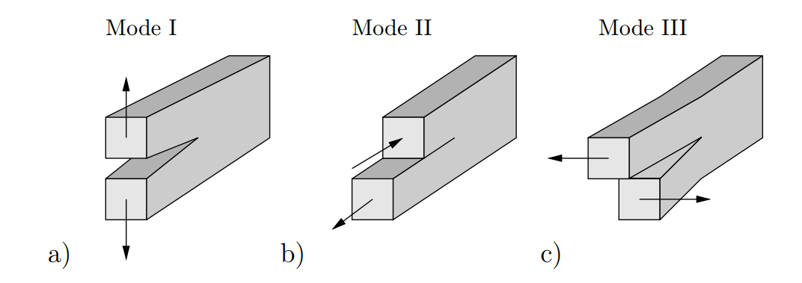
Cracks in continuum mechanics
Cracks in continuum mechanics | Simulating Cracks | In-house built Algorithm | Examples | Conclusion
A crack is a discontinuity in a solid body which is characterized by possessing an initiation (or nucleation) point and by growing from this point to a finite size with time, either leading, or not, to the division of the initial body in two or more pieces. Prof. C.G. Schön
Characterizing refracture materials
  Constitutive model
  Optimization
    Crack nucleation
    Crack propagation
2
Notes:
Within the project we are trying to characterize refracture materials in more detailed manner of which a part of is a crack formation in severe working conditions.
I’ve attached a photo of a standard book-example of crack for your easier visualization.
.
Definition of crack tends to be interesting question as it is not common in the literature to have it written in the form such as “Cracks is. something.”
Prof. Schon from Sao Paolo tried to define it in more engineering matter in these form.:
To define a crack I found great engineering definition from prof, Schon from Sao Paolo.
…..A crack is a discontinuity in a solid body which is characterized by possessing an initiation (or nucleation) point and by growing from this point to a finite size with time, either leading, or not, to the division of the initial body in two or more pieces. Prof. C.G. Schön
.
First task of course is to develop a constitutive model for which other collaguages are in charge and then to optimize parts in physical use. For such optimization we have to understand current problems occurring in regular exploitation which brings us to studying cracks. At this time focus is only on 2D case and Mode 1 type of cracks. Therefore one of a first focuses here in the research is to develop a tool for practical analysis of crack formation both it’s nucleation and propagation
.
.
.
Source . downloaded thesis
Google vesuvius ladle shroud

Slide 3
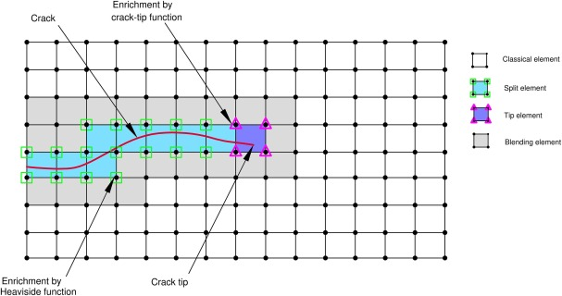
Simulating cracks
Cracks in continuum mechanics | Simulating Cracks | In-house built Algorithm | Examples | Conclusion
XFEM
More advanced - flexibility of propagation direction
More demanding - harder to implement
Not available in all software packages
Ability of XFEM to work with more sophisticated material models (user defined material models - UMAT)
Two most common methods
  Cohesive elements
  Extended finite element method (XFEM)
3
Notes:
For simulating crack there are several methods in use, among which these 2 are the most popular. First and more simpler one is by using cohesive elements while more advanced one is extended finite element method also known as XFEM which enables flexibility in propagation of crack. This is significant as crack propagate through the continuous element and divides it in 2 pieces. Such propagation enables more realistic behaviour and it is not mesh dependent.
.
A side of its benefits it’s also more demanding in computation and also harder to implement. Another downside is that it is not available in all software packages.
.
In the picture you can see natural crack propagation through the elements where the ones marked with blue colors are the ones that are splitting, the one where the tip of the crack is and new surface is forming is marked with purple and gray ones are the ones that are adjusting to the movements of blue elements while obviously red line represents crack path.
.
.
.
XFEM does it’s job by extending the classical finite element method (FEM) approach by enriching the solution space for solutions to differential equations with discontinuous functions.
.
Source: https://www.sciencedirect.com/science/article/pii/S0167844220303281

Slide 4
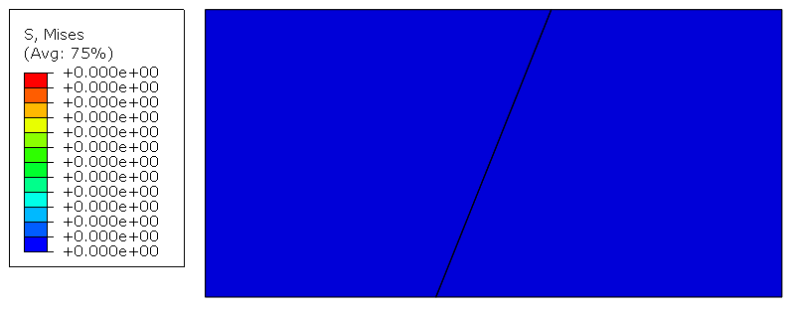
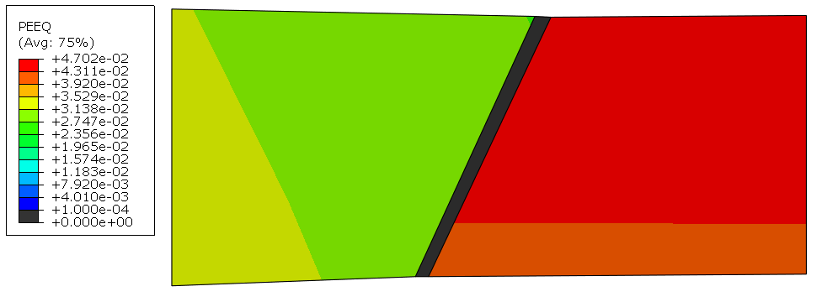
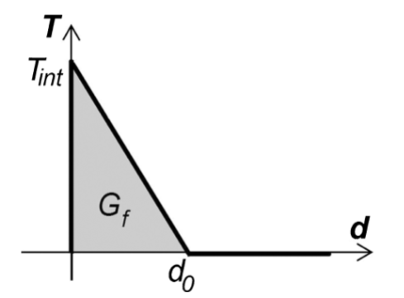
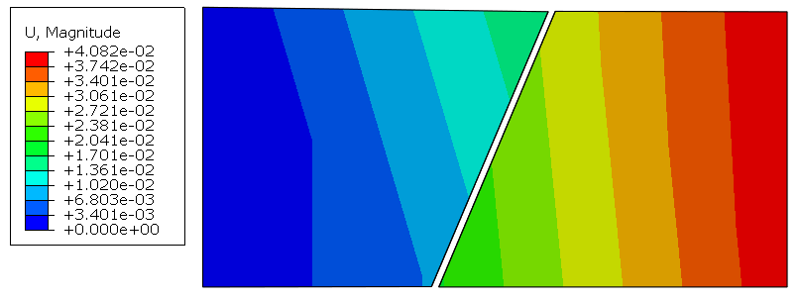
Cracks in continuum mechanics | Simulating Cracks | In-house built Algorithm | Examples | Conclusion
Cohesive elements
Initially created for cohesive zone
Zero thickness
  Cracks
Crack path dependent
  Crack moving on the boundaries of the elements
Difference in comparison to continuum elements
  Traction separation law
4
Notes:
Back to the simpler ones! Cohesive elements, which were initially designed to stimulate adhesives soon were adapted to be used for simulating cracks. Important difference between 2 cases is that adhesive zone has an initial thickness while cohesive elements meant to simulate crack are in the beginning zero thickness and therefor invisible in visualizations of the mesh before loading.
.
Simulating cracks with cohesive elements is mash dependent or to be more precise crack path dependent which leads to fine mashing in the crack zone and still unavoidable dependency on elements boundaries.
.
Traction separation law defines the behaviour of cohesive element in a way that when a specified value is reached propagation follows in defined line until a certain elongation is reached after which they break (as adhesive would). There are also other traction separation laws, for example defined with energy. In cohesive elements we are trying to, first, make stiffness (Tint) high enough so that continuum domain doesn’t lose its properties but then to break when a certain criterion is met (like any criterion used for crack initialization) and after some very short elongation to break completely.
.
Pokazati na srednjoj slici da se cohesivni element otvorio…cudno je da su lijeva i desna strana drugacije
Crack path dependent …ne mash dependant

Slide 5
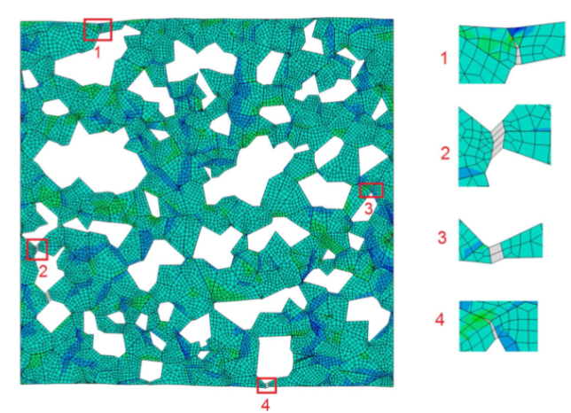
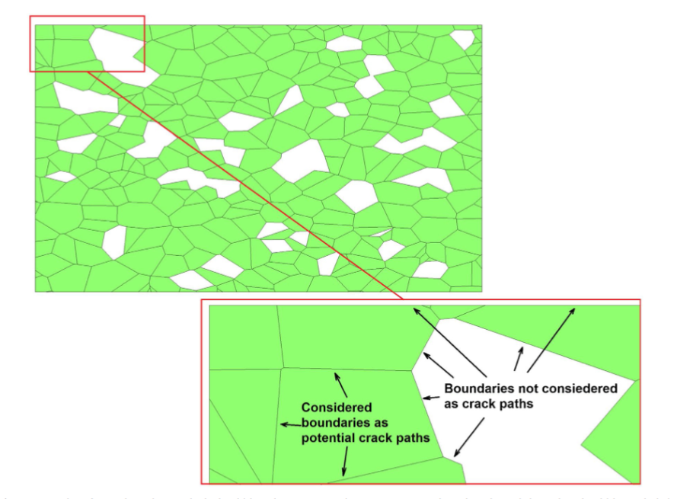
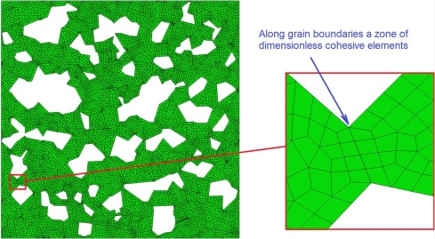
Cracks in continuum mechanics | Simulating Cracks | In-house built Algorithm | Examples | Conclusion
Example of usage of cohesive elements
Cohesive elements are inserted along grain boundaries to model intercrystalline cracking.
Porosity is reproduced by eliminating some grains
Gray cohesive elements means that they are degraded
V. Buljak, G. Bruno: Numerical modeling of thermally induced microcracking in porous ceramics: an approach using cohesive elements;
Journal of the European Ceramic Society, 38 (11) (2018), pp. 4099-4108
5
Notes:
Great example of such usage is one paper of my mentor prof. Buljak where ceramic behaviour was depicted by using cohesive elements on all boundaries of grains in ceramic material.
The voids you see are porosity introduced by eliminating some of the elements as in real ceramics, which are, in simulation, causing high stress points. After loading, on the next picture, you can see stretched cohesive elements being gray which means they already “broke” but are still there to be aware of its former presence.
Source: https://reader.elsevier.com/reader/sd/pii/S0955221918301870?token=B98CA996315D557C120D16A270C1AD11EC6C9823239E75FC848294CC262FA9436480DCE01DCB3CB0AB59E1E917DC7FD2&originRegion=eu-west-1&originCreation=20220830125149

Slide 6
PROS and CONS both methods
Cracks in continuum mechanics | Simulating Cracks | In-house built Algorithm | Examples | Conclusion
 | PROS | CONS
COHESIVE ELEMENTS | Implementation Computation Compatible with complex constitutive models | Crack path dependent Propagate only on predefined paths Not very robust
XFEM | Not crack path dependent Unconstrained crack propagation paths | Expensive for computation Hard to use with complex constitutive models
6
Notes:
To recap the Pros and Cons of both options.
.
Cohesive elements are easier for implementation in various cases, also they are not that expensive in computation cost - considering time. Various cases means - they are better for covering cases with more demanding constitutive models in which one would like to simulate crack.
On contrary they are crack path dependent, sometimes sensitive to the quality of mesh, and dependent on discretization for crack propagation which represents their biggest downside.
.
While XFEM is good and sometimes more reliable because it doesn’t limit any analysis to define where the crack will occur, no discretization is needed. That is nice, but it goes with a price tag of expensive computation and it can be hard to implement in non simple simulations. It is also expensive for computation and it can be hard to use it with complex constitutive models.

Slide 7
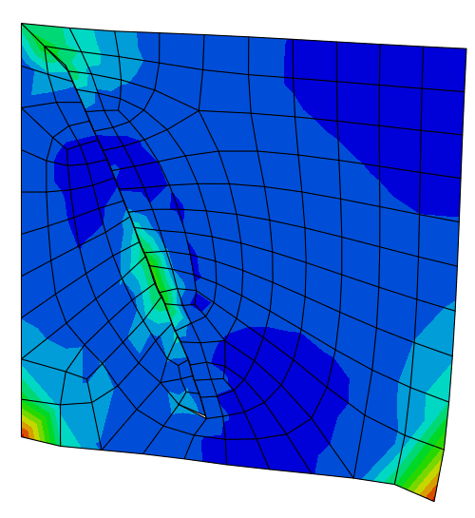

Algorithm for automatic implementation of cohesive elements
Cracks in continuum mechanics | Simulating Cracks | In-house built Algorithm | Examples | Conclusion
Cracks in continuum mechanics | Simulating Cracks | In-house built Algorithm | Examples | Conclusion
The goal is to develop a tool capable of automatic inserting cohesive elements in zone of interest (high stress) to analyze crack initialization.
Addressing the constraints of cohesive elements.
  Proposed direction of propagation - good for
  initialization
  Adjusted boundaries of elements - seeding the line
Meeting partners requirements - developing the tool for
analyzing the problem they are facing.
7
Notes:
The need for simulating cracks in brittle materials came through the need of our project partner which has parts in severe working conditions. Due to expected complexity in constitutive model of the material we decided to create an environment easy to use for simulating cracks, and therefore we started working on algorithm for automatic implementation of cohesive elements.
.
The ultimatum goal is to have a tool capable of automatic insertion of cohesive elements in zone of interest where zone of interest can be defined by different parameters. All of that with the main idea of better understanding crack initialization.
.
To address the downsides of cohesive elements our code is capable of finding zone of interest based on initial simulation of continuum model and defined criteria, after which post-processing of simulation parameters happens and cohesive elements are inserted and second discretized model is created. This presents one of the advantages of the whole approach as we have 2 models, first one with continuum elements and second one with cohesive elements.
.
The tool is still based on 2D cases and in this first -top figure, you can see first model - mesh and boundary conditions, and on second bottom figure results of simulation of second model with implemented cohesive elements.
Dolasci …napravi doalske teksta i slika po potrebi
Rezultati continuum modela … pa neke strelice da se vide gdje je highest principle stresses ←

Slide 8
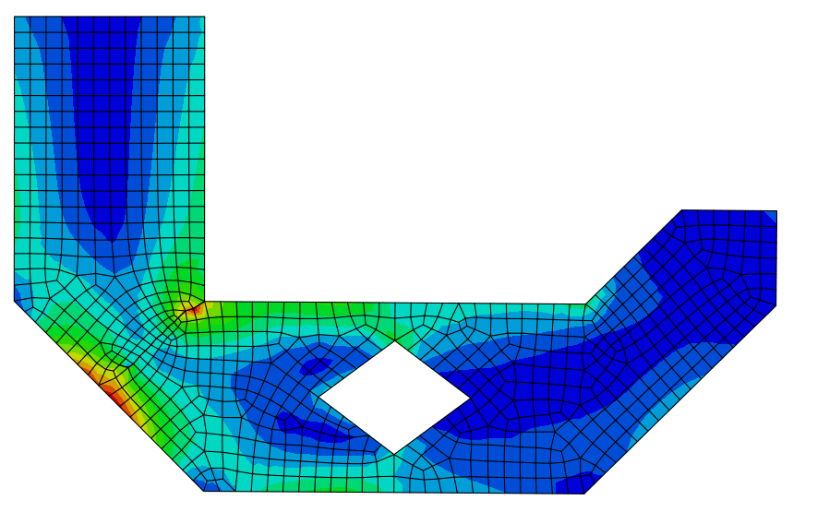
Sequence
Cracks in continuum mechanics | Simulating Cracks | In-house built Algorithm | Examples | Conclusion
Continuum model - input
  Geometry
  Boundary conditions
Post-processing - with written scripts
  Principal stresses (Intensity and direction)
  Equivalent plastic strain
Discretized model with cohesive elements
8
Notes:
To better understand sequence of how it works, let’s go through the steps.
.
As an input geometry and boundary conditions are needed, in our case this comes from initial setup of Abaqus simulations and .geo code from Gmsh.
First simulations is done with continuum elements after which post-processing is done with in-house build scripts.
Results of simulations are scraped for defined criteria, in our case for simpler case Gauss Points with highest principle stresses, and based on that data mesh is adjusted with implemented cohesive elements.
After this second simulation is done and results are available for inspection.

Slide 9
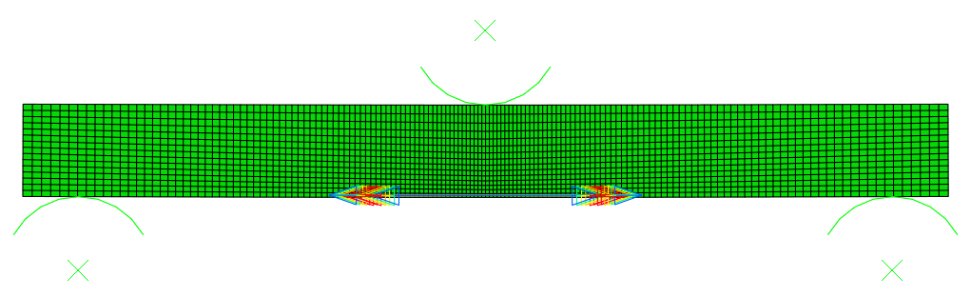
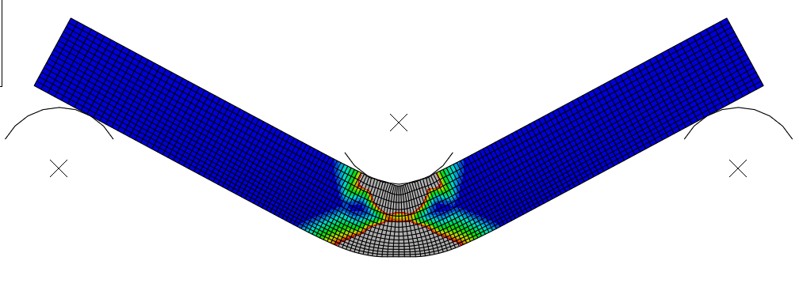
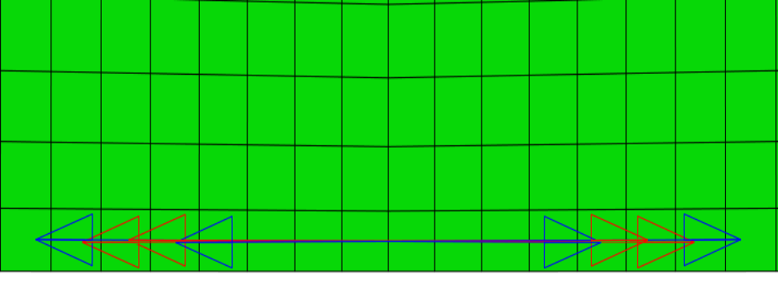
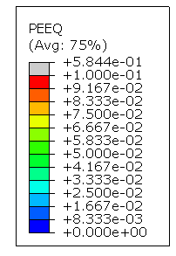
Crack initialization criteria
Cracks in continuum mechanics | Simulating Cracks | In-house built Algorithm | Examples | Conclusion
Cracks in continuum mechanics | Simulating Cracks | In-house built Algorithm | Examples | Conclusion
First criterion
  Gauss Point with the highest principle stresses
Second criterion
  Min 10% of accumulated plastic strain
9
Notes:
Very important aspect of the simulation is Crack initialization criterion
Our first simulations were using only Highest Principle Stresses, by which scripts were tested.
Currently we are trying to enrich the model with additional criteria to exploit benefits of cohesive elements. In connection to that now we are using accumulated plastic strain as a second eliminating parameter.
.
Keeping in consideration that the whole tool is developed for brittle materials and here we are testing ductile ones, still this is used to test the newly defined criteria.
.
On the right pictures you can see
CRITERION ne CRITERA (množina)
Možda čak da i nije pravi numerički model …više generalno shematski o čemu je riječ … ne fem model
“Mehanika krumpira” - ako to stignem provjeriti sa perform sta jebolje

Slide 10
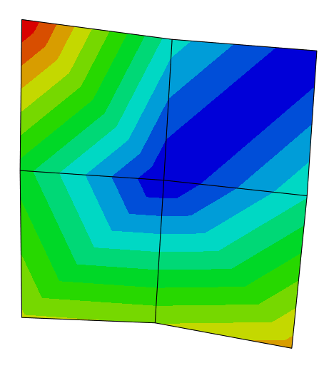
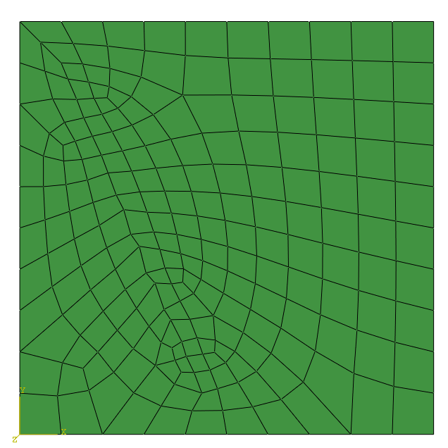
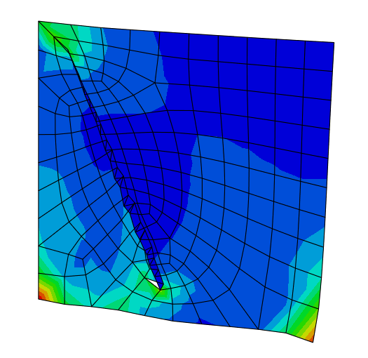
Case study 1 - Simple geometry
Cracks in continuum mechanics | Simulating Cracks | In-house built Algorithm | Examples | Conclusion
Cracks in continuum mechanics | Simulating Cracks | In-house built Algorithm | Examples | Conclusion
Input
  Geometry
  Mash
  Boundary conditions
First simulation
Post-processing
  Cohesive elements implemented
Second simulation
Constitutive model used:
  Solid continuum elements
    Linear elasticity
  Cohesive elements
    Elasticity
    Traction separation law
      Damage criterion - MAXS
      Displacement control (linear)
10
Notes:
Now I would like to present few case studies of implementation of previously described approach.
.
On the first figure presented you can see initial very simple input of both simple geometry and boundary conditions, where on the left side we have fixed nodes and on the right bottom displacement.
.
After simulations we can see results of continuum model where high principal stress points are in the top left corner. In the top left Gauss Point there is a highest value and together with the real coordinates of that point and adjacent vector of principle stress, line is inserted in the mesh for seeding new nodes which will form cohesive elements.
.
Third figure presents newly created mesh with inserted zero thickness cohesive elements.
.
Finally the last figure presents results of second simulations where cohesive elements went in the negative value as they do not differ compression and tension. In next pictures we will see more practical implementation cases.
Gaus tocka najbliza lijevom gornjem kuglu

Slide 11
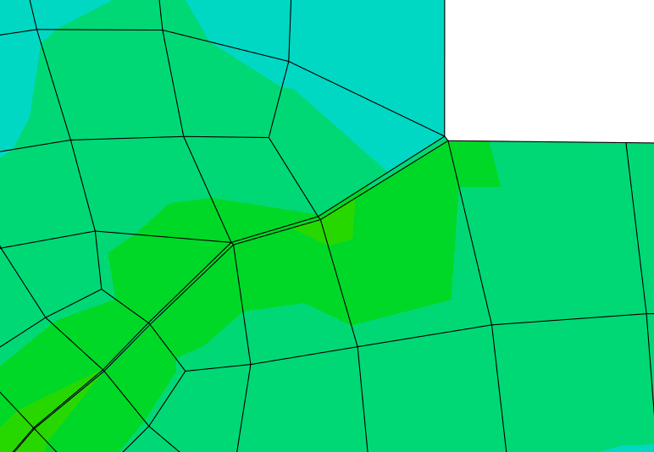
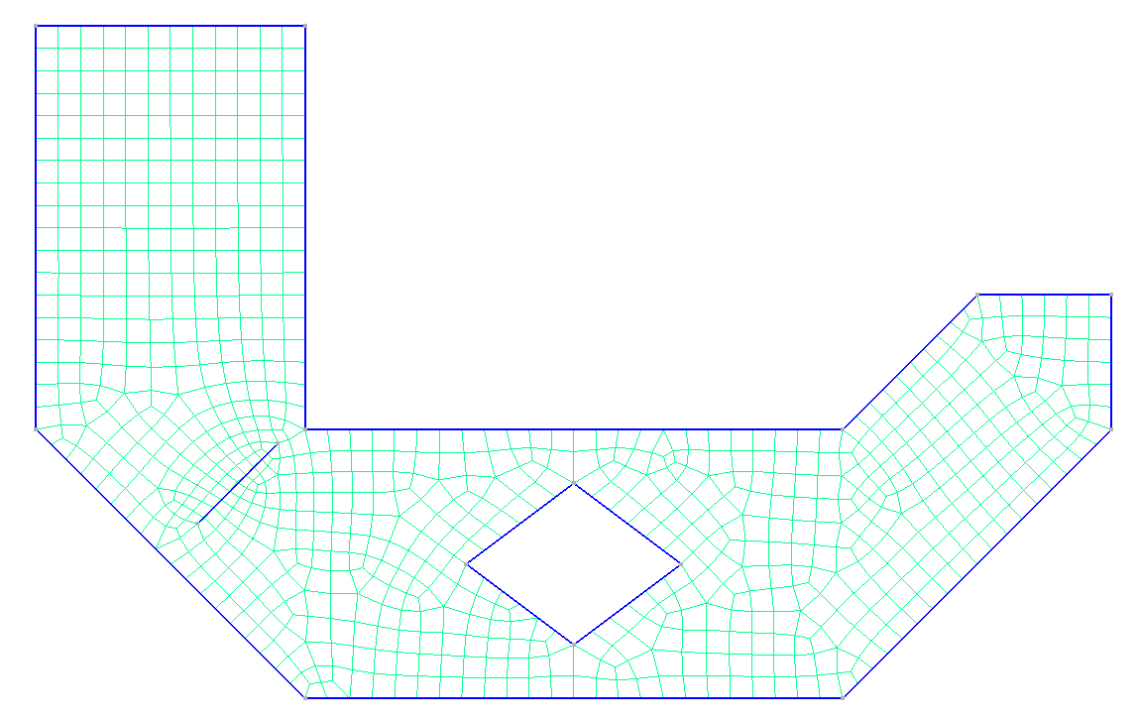
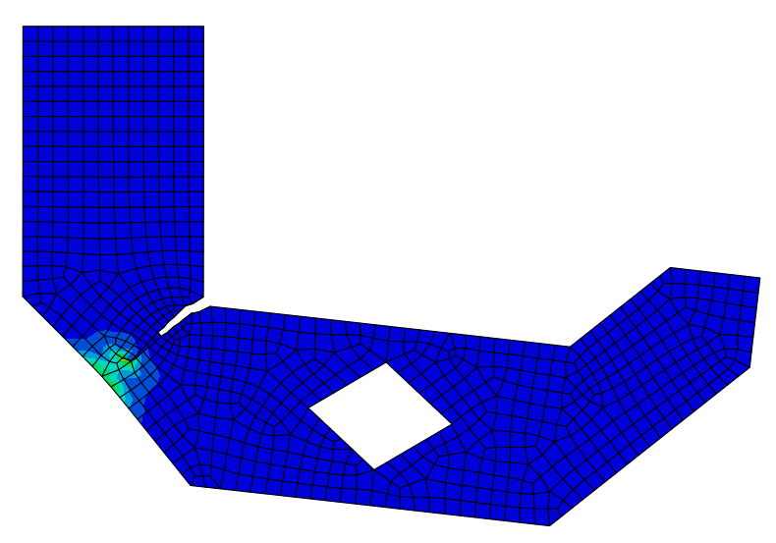
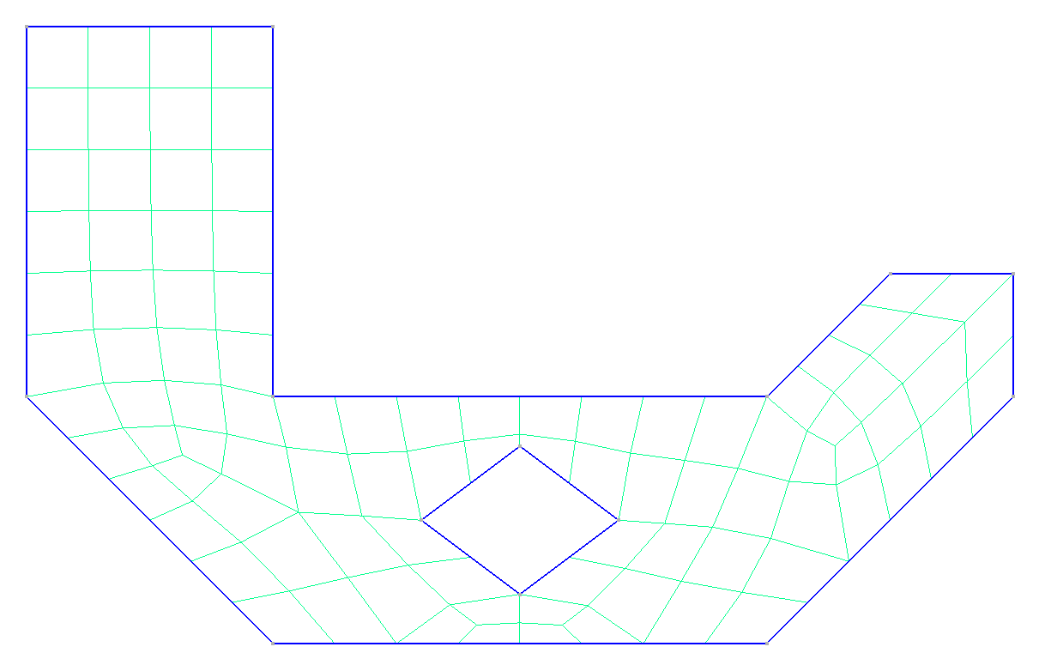
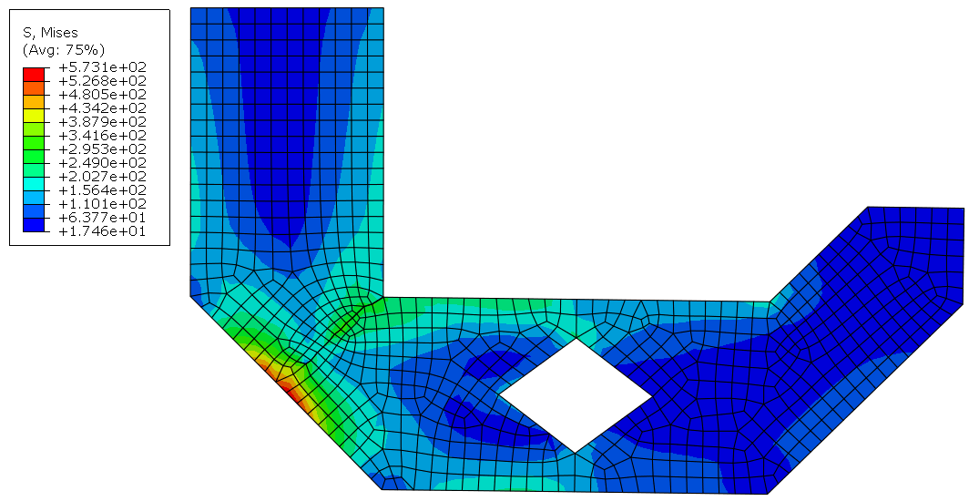
Case study 2 - More complex geometry
Cracks in continuum mechanics | Simulating Cracks | In-house built Algorithm | Examples | Conclusion
11
Notes:
In this case study, where geometry is slightly more complex in comparison with previous one, again first pictures presents initial inputs for first simulation with continuum elements only.
.
In this case in the 90 degree corner we expect to have highest principle stresses. Again by using coordinates of the Gauss Point of highest principle stress and it’s vector we are constructing the line for seeding new nodes and elements which is visible in the second figure.
.
Second simulation is done with implemented cohesive elements and in analysis of results we can first see behaviour of traction separation law in which elements first start to open and grow before reaching maximal prescribed displacement, after which they are completely degraded and if we delete them crack is visible.
..promijentii crticu do kuta a ne ovako kako je

Slide 12
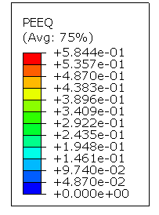
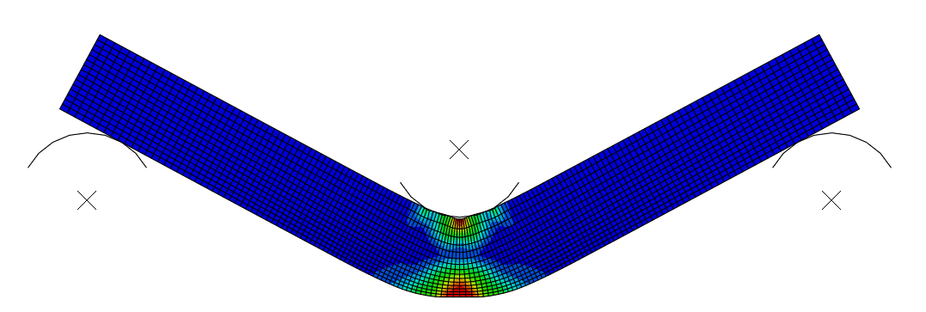
Case study 3 - Tree point bending test with plasticity
Cracks in continuum mechanics | Simulating Cracks | In-house built Algorithm | Examples | Conclusion
Constitutive model used:
  Solid continuum elements
    Linear elasticity
    Plasticity with hardening
  Cohesive elements
    Elasticity
    Traction separation law
      Damage criterion - max stress (MAXS)
      Displacement control (linear)
Crack initialization criteria
  Gauss Point with the highest principle stress (with its vector)
  Accumulated plastic strain (PEEQ)
12
Notes:
Third and final case study covers the case where two crack initialization criteria are used.
.
First one as in previous cases is highest principle stress, and the second one value of PEEQ.
.
First figure here presents continuum model in which we can see there there is more than 10% of accumulated plastic strain, which together with highest principle stresses satisfies both conditions for inserting the line and implementing cohesive elements in the critical cross section.
In second figure we can see results of second simulation in which cohesive elements are present where before opening we can see some accumulation of plastic strain and then opening of elements like it is supposed to happen.
.
.
.
Due to sensitivity of the traction separation law it’s not possible to expect the minimum required PEEQ as in criteria but still this are more important in continuum model, while here we are more interested in when the elements start to develop.

Slide 13
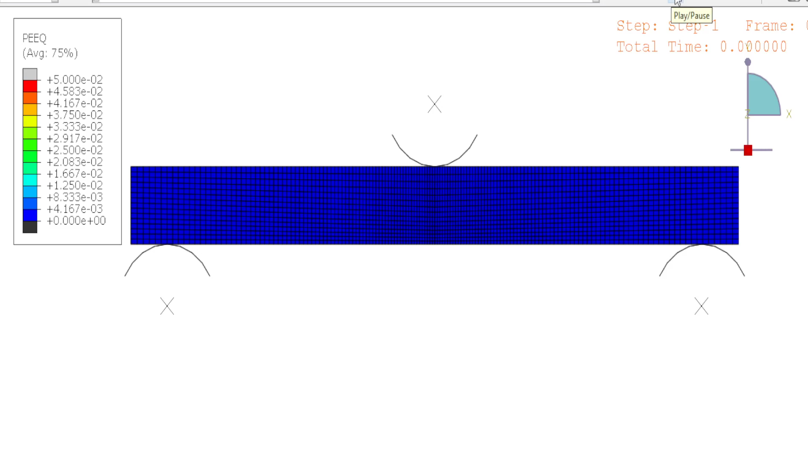
Case study 3 - Tree point bending test with plasticity
Cracks in continuum mechanics | Simulating Cracks | In-house built Algorithm | Examples | Conclusion
Constitutive model used:
  Solid continuum elements
    Linear elasticity
    Plasticity with hardening
  Cohesive elements
    Elasticity
    Traction separation law
      Damage criterion - max stress (MAXS)
      Displacement control (linear)
Crack initialization criteria
  Gauss Point with the highest principle stress (with its vector)
  Accumulated plastic strain (PEEQ)
12
Notes:
Third and final case study covers the case where two crack initialization criteria are used.
.
First one as in previous cases is highest principle stress, and the second one value of PEEQ.
.
First figure here presents continuum model in which we can see there there is more than 10% of accumulated plastic strain, which together with highest principle stresses satisfies both conditions for inserting the line and implementing cohesive elements in the critical cross section.
In second figure we can see results of second simulation in which cohesive elements are present where before opening we can see some accumulation of plastic strain and then opening of elements like it is supposed to happen.
.
.
.
Due to sensitivity of the traction separation law it’s not possible to expect the minimum required PEEQ as in criteria but still this are more important in continuum model, while here we are more interested in when the elements start to develop.

Slide 14
Case study 3 - Tree point bending test with plasticity
Cracks in continuum mechanics | Simulating Cracks | In-house built Algorithm | Examples | Conclusion
Constitutive model used:
  Solid continuum elements
    Linear elasticity
    Plasticity with hardening
  Cohesive elements
    Elasticity
    Traction separation law
      Damage criterion - max stress (MAXS)
      Displacement control (linear)
Crack initialization criteria
  Gauss Point with the highest principle stress (with its vector)
  Accumulated plastic strain (PEEQ)
12
Notes:
Third and final case study covers the case where two crack initialization criteria are used.
.
First one as in previous cases is highest principle stress, and the second one value of PEEQ.
.
First figure here presents continuum model in which we can see there there is more than 10% of accumulated plastic strain, which together with highest principle stresses satisfies both conditions for inserting the line and implementing cohesive elements in the critical cross section.
In second figure we can see results of second simulation in which cohesive elements are present where before opening we can see some accumulation of plastic strain and then opening of elements like it is supposed to happen.
.
.
.
Due to sensitivity of the traction separation law it’s not possible to expect the minimum required PEEQ as in criteria but still this are more important in continuum model, while here we are more interested in when the elements start to develop.

Slide 15
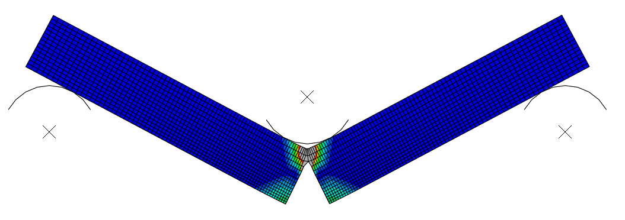
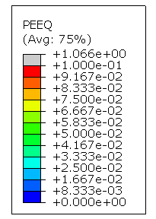
Case study 3 - Tree point bending test with plasticity
Cracks in continuum mechanics | Simulating Cracks | In-house built Algorithm | Examples | Conclusion
Constitutive model used:
  Solid continuum elements
    Linear elasticity
    Plasticity with hardening
  Cohesive elements
    Elasticity
    Traction separation law
      Damage criterion - max stress (MAXS)
      Displacement control (linear)
Crack initialization criteria
  Gauss Point with the highest principle stress (with its vector)
  Accumulated plastic strain (PEEQ)
12
Notes:
Third and final case study covers the case where two crack initialization criteria are used.
.
First one as in previous cases is highest principle stress, and the second one value of PEEQ.
.
First figure here presents continuum model in which we can see there there is more than 10% of accumulated plastic strain, which together with highest principle stresses satisfies both conditions for inserting the line and implementing cohesive elements in the critical cross section.
In second figure we can see results of second simulation in which cohesive elements are present where before opening we can see some accumulation of plastic strain and then opening of elements like it is supposed to happen.
.
.
.
Due to sensitivity of the traction separation law it’s not possible to expect the minimum required PEEQ as in criteria but still this are more important in continuum model, while here we are more interested in when the elements start to develop.

Slide 16
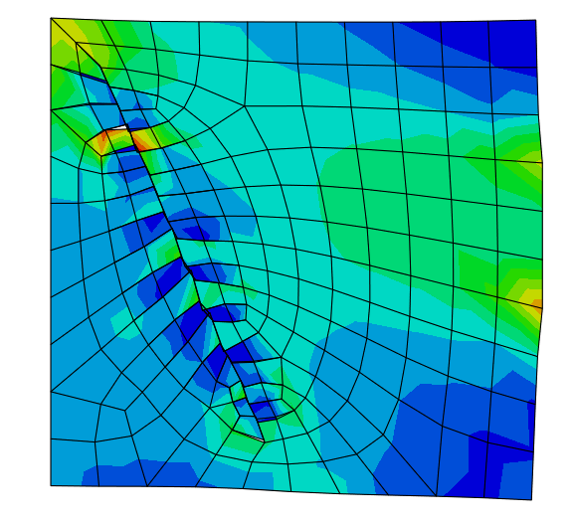
Research paths
Cracks in continuum mechanics | Simulating Cracks | In-house built Algorithm | Examples | Conclusion
Branching
  Biggest downside
  The most challenging next steps
Low quality case study (right figure)
  Not promising results till now
12
Notes:
Shortly I would also like to point out that we were exploring other paths. For example enriching the model with additional cohesive elements in the first element boundaries that are in contact to main inserted line, but for now this model didn’t show promising results as this case study was not very good for research of branching. This topic has to be researched in more detail.

Slide 17
Conclusion and downsides
Cracks in continuum mechanics | Simulating Cracks | In-house built Algorithm | Examples | Conclusion
In-house build code for implementation of cohesive elements.
  Based on different criteria
  Code flexible for expansions to additional criteria
Efficient in computation
  Continuum model enriched with more demanding computational elements only in area of interest
Mesh dependency
  Challenging treatment of crack branching
Implementing additional criteria is not straightforward and fast
13
Notes:
Finally to extract some conclusions. Our in house build code if capable of implementing cohesive elements in continuum models based on different criteria, this way we are exploiting good sides of cohesive elements in usage for simulating cracks and partially minimizing it’s problems with mesh dependency.
The scripts are upgradable to other different criteria and there for relatively efficient in examining cases in 2D domain.
.
On the other hand we see some downsides and limitations. Even after addressing the mesh dependency it is impossible to have it completely independent as in XFEM. The most questionable next step is how to treat crack branching. The method is upgradable but it is not very easy and fast till now and therefore for a first implementation of new criteria additional is needed.

Slide 18
Advanced ceramics and application conference X
Serbian Ceramic Society
Thank you for your attention!
Acknowledgments to the funds received from the European Union’s Horizon 2020 research and innovation programme under the MSC grant agreement No 955944 - RE-FRACTURE2.
Domagoj Uremović
duremovic@mas.br.ac.rs
This project has received funding from the European Union’s Horizon 2020 research and innovation programme under the Marie Sklodowska-Curie grant agreement No 955944 - RE-FRACTURE2.

