Slide 1
COMPUTATIONAL IMPLEMENTATION AND VALIDATION OF THE CONSTITUTIVE MODEL FOR THE REFRACTORY MATERIAL
Jovana Stojić, Massimo Penasa
This project has received funding from the European Union’s Horizon 2020 research and innovation programme under the Marie Skłodowska-Curie grant agreement No 955944 – RE-FRACTURE2.​​

Slide 2
TABLE OF CONTENTS
INTRODUCTION
MOTIVATION
Basic information about the personal role in the project RE-FRACTURE2
Illustration of the problem of defining and implementing the constitutive model for refractories
4
1
2
FUTURE STEPS
CURRENT STATE
3
Goals and intentions regarding improvement
Outcome of the analyses using developed subroutine and their validation

Slide 3
INTRODUCTION
Implementation of the constitutive models for the high temperature behavior of refractory materials in routines for finite elements computations
Extension of the open-source FE software to allow the description of the thermoplastic instabilities
Applying the most advanced techniques for efficient solution of highly nonlinear problems

Slide 4
MOTIVATION
Possess high thermal strength at elevated temperatures ➔ widely used in steel and iron production​
Wide working temperature range ➔ fractures, thermal shock​
Demand for the new refractory parts ➔ higher emission of CO2​
Varying material properties dependent on the temperature ➔ complex behavior​
Critical component – ladle shroud; it is necessary for it to withstand thermal shock and high temperature range

Slide 5
STAGES OF DEVELOPMENT
Cam Clay yield function; linear hardening
Cam Clay yield function; hardening with Bezier curves definition
1
2
3
4
Bigoni-Piccolroaz yield function; hardening with Bezier curves definition
Temperature dependency; customized function for elastic modulus

Slide 6
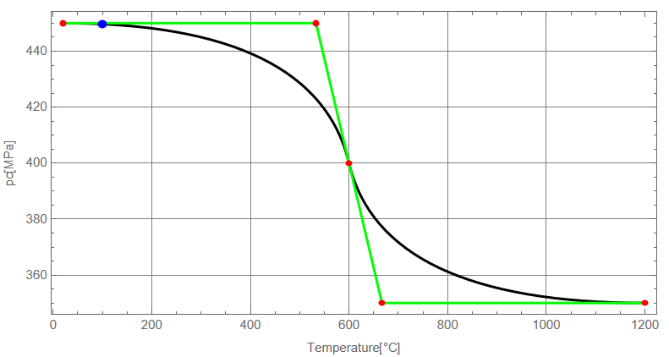
BEZIER CURVES
3 points defined (pc, temperature, slope)
2 additional points obtained
2 second order curves
pc corresponding to the temperature retrieved

Slide 7
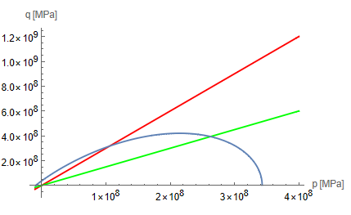
VALIDATION OF THE YIELD POINT
finding the solution of the system of the equations
checking in the simulation results if the plastic deformation occurs; comparing the obtained third invariant and the pressure

Slide 8
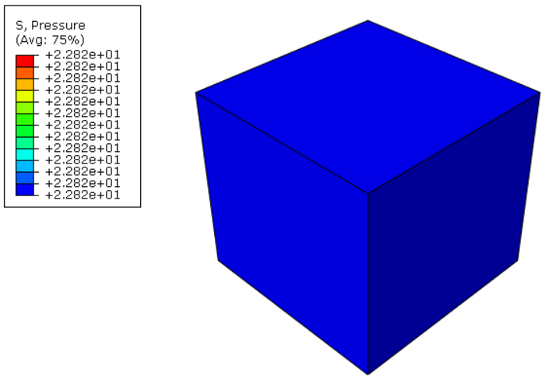
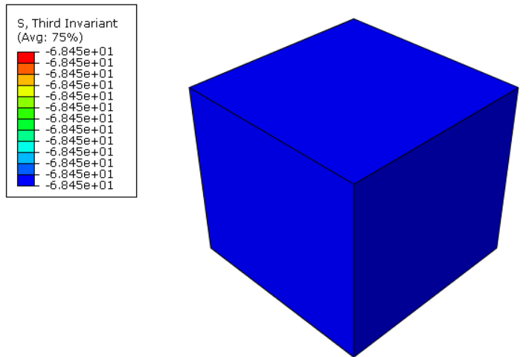
Results in Mathematica notebook for p and q
ABAQUS results for p and q using the developed UMAT

Slide 9
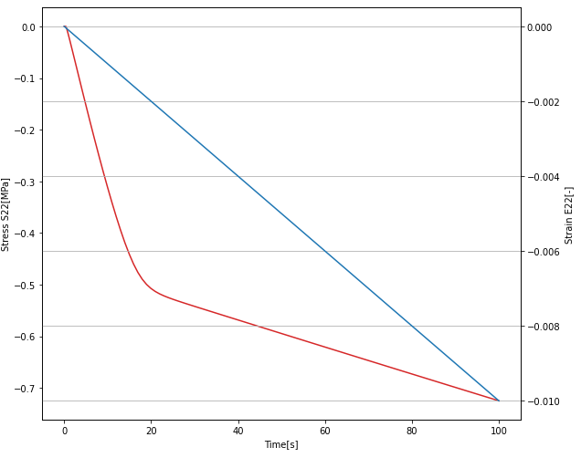
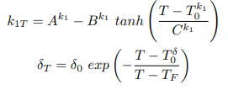
DEFINITION OF THE HARDENING LAW
-

Slide 10
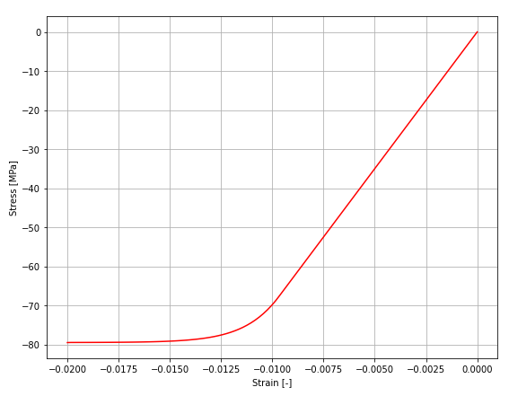
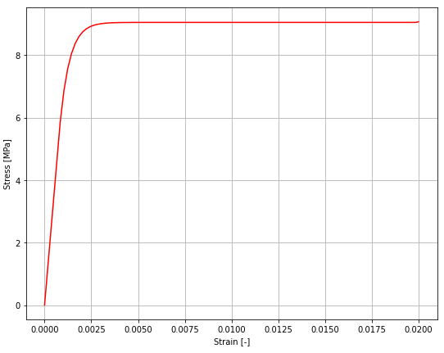
BEHAVIOR IN COMPRESSION/TENSION
The curve obtained when specimen was loaded in compression
The curve obtained when specimen was loaded in tension

Slide 11
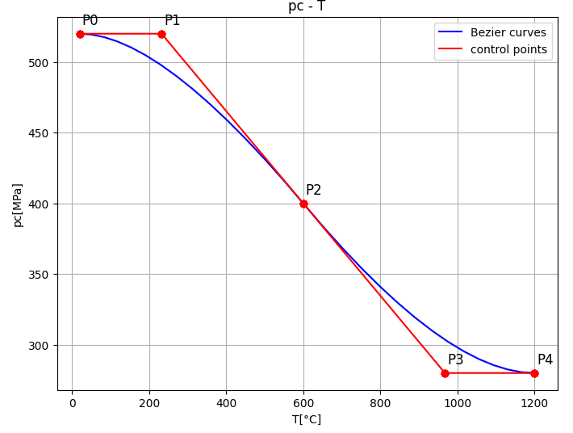
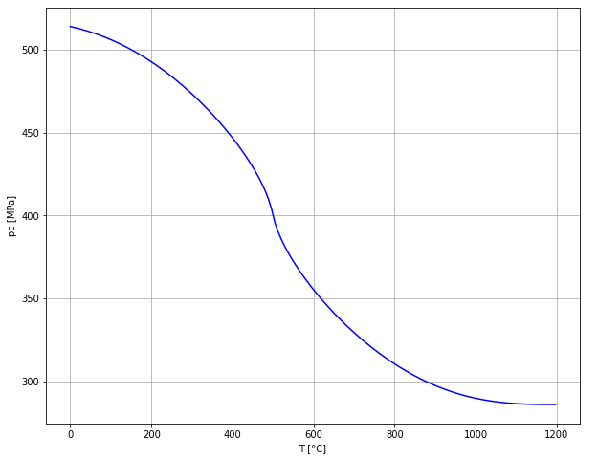
COMPARING THE STATE VARIABLE PC
The curve obtained in the Python function
The curve extracted from ABAQUS results

Slide 12
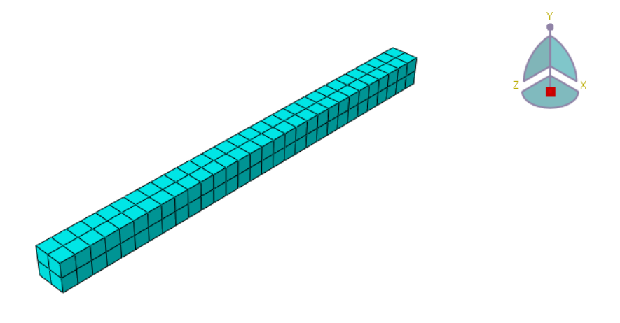
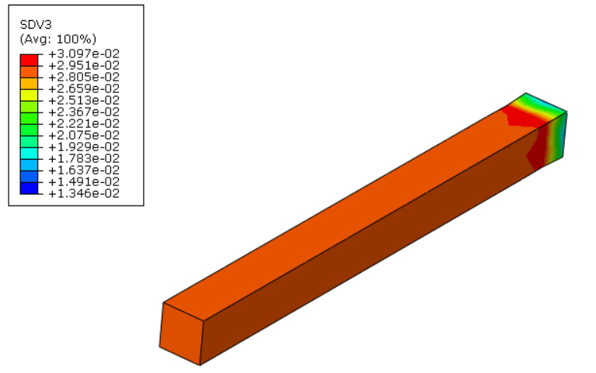
CANTILIEVER BEAM
Model of a beam in an uniaxial test (tension applied)
Different material properties' values, so the hardening law is nonlinear

Slide 13
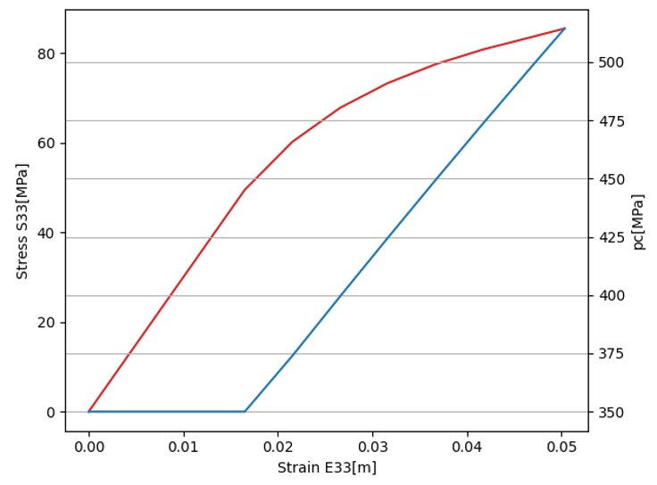
NONLINEAR HARDENING FOR THE BEAM MODEL
[-]

Slide 14
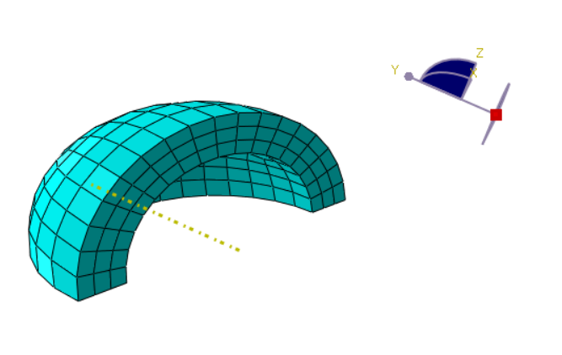
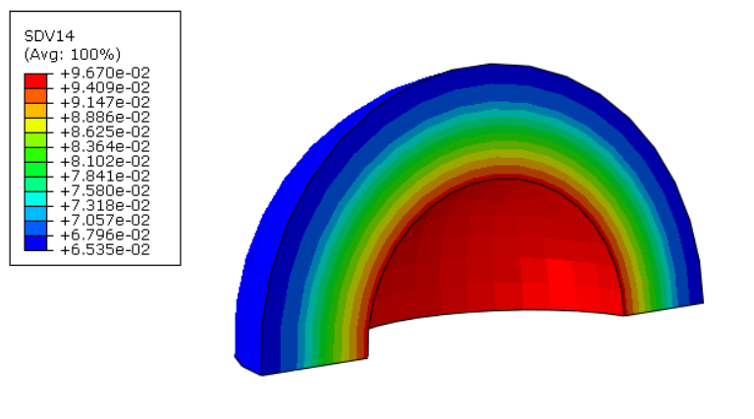
SPHERICAL MODEL
Quarter of the sphere; internal surface blocked, on the external one the pressure is applied
Cumulative plastic strain as state variable number 14

Slide 15
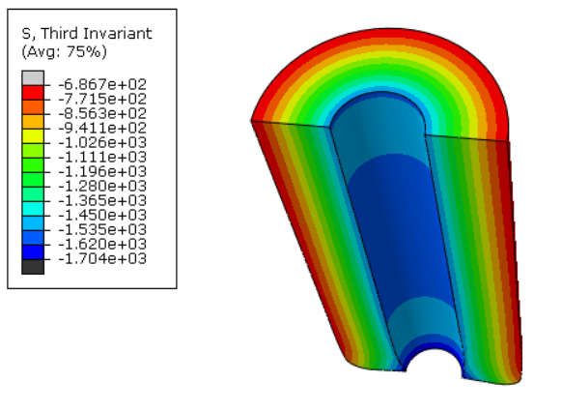
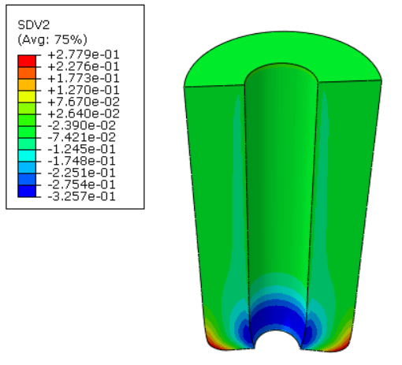
COMPONENT OF THE HEAT RESISTANT DEVICE (LADLE SHROUD)
Heat-resistant device loaded with pressure on the external surface

Slide 16
FUTURE DEVELOPMENT
Redefinition of the hardening law
Linear/polynomial regression
Fitting the curve between the experimental points
Damage described using the phase field modeling

Slide 17
THANK YOU FOR YOUR ATTENTION!
E-mail: stojic.jovana98@gmail.com
LinkedIn: Jovana Stojić
CAEmate
Sites: https://caemate.com
https://www.refracture2-h2020.eu

