Slide 1
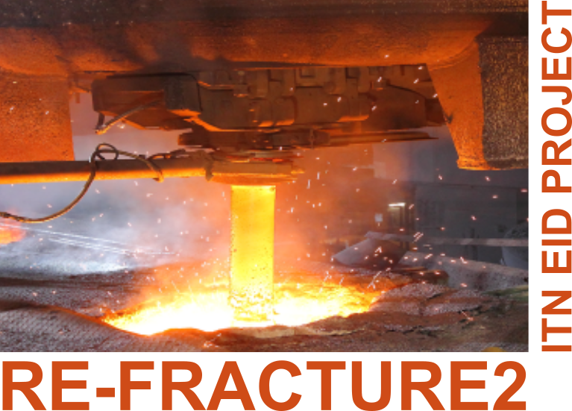
Mathematics and Mechanics of Solids and Structures June 07-09, 2023, Aberystwyth
Algorithm for adaptive line insertion for anticipating crack path trajectory
Domagoj Uremović | Vladimir Buljak
This project has received funding from the European Union’s Horizon 2020 research and innovation programme under the Marie Sklodowska-Curie grant agreement No 955944 - RE-FRACTURE2.

Slide 2
Crack path trajectory - intorduction ●○ | Traction separation law and criterion ○ | Methodlogy overview ○○ | Results ○○○ | 2/10
 | Final conditions
Initial conditions
Force – displacement curve | Final conditions
$$Force$$
$$Dispalcement$$
Notes:
This slide is here to give an idea of the general input and expected result/output. What we have in the beginning and what we want to have as the output – starting from continuum model and iterative models with discontinuous cohesive elements to obtain cracked domain and results we can pull out of it. Also to very briefly mention a global picture – by having a knowledge about crack path trajectory – we can address some areas to deviate it or stop it or do something to enlarge total fracture energy.

Slide 3
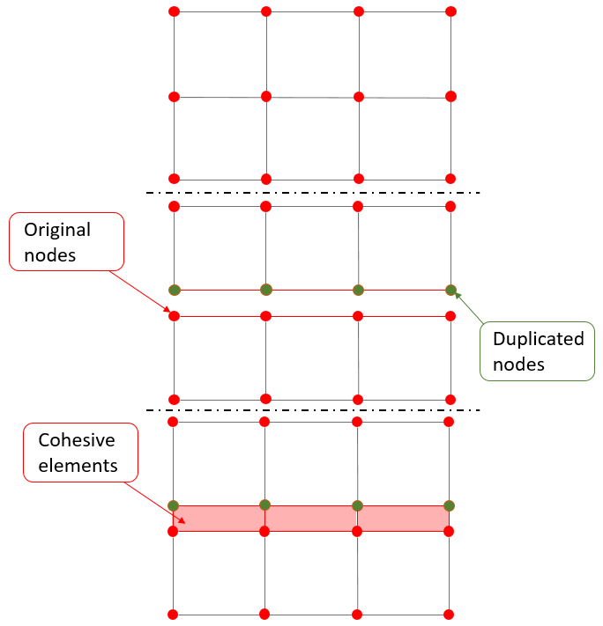
Crack path trajectory - intorduction ○● | Traction separation law and criterion ○ | Methodlogy overview ○○ | Results ○○○ | 3/10
Cracking modes in 2D
 | Cohesive elements
Mode I – Opening in tension
Mode II – Shearing in plane
Notes:
Brief introduction in the most important aspects of fracture and discontinuous cohesive elements used for simulating fracture in fem. What type of fracture modes do we have in 2D domain and that we are interested in the Mode I For COH EL – starting from continuous mesh – duplicating nodes – adjusting connectivity matrices of continuous elements and creating new coh el-s

Slide 4
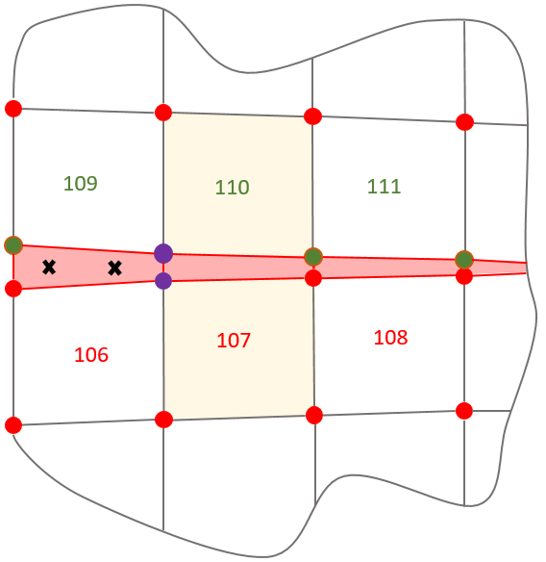
Crack path trajectory - intorduction ○○ | Traction separation law and criterion ● | Methodlogy overview ○○ | Results ○○ | 4
Traction separation law | Crack propagation criterion and tailoring method
Traction separation law | Crack propagation criterion and tailoring method
$$σ$$
2
y
Damage initiation
$$T$$
$$θ_{p}$$
$${ G}_{f}$$
$$σ_{2}$$
Elastic
Linear
behaviour
Damage evolution (softening) LINEAR
$$σ_{1}$$
1
Damage evolution (softening) EXPONENTIAL
$$θ_{p}$$
0
x
$$σ_{1}$$
$$δ_{c}$$
$$δ_{f_{l}}$$
$$δ_{f_{e}}$$
$$separation$$
$$σ_{2}$$
Domagoj Uremović (UniBg | CAEmate) | Aberyswyth conference | 9 June 2023 | 2/10
Notes:
What derives behavior of Cohesive elements – traction separation law. How is it assembled and what are it’s main values. There are many of them – we are considering linear and exponential – and it is observed that exponential offers more stability in numerical simulations
Very important aspect – criterion for initiation and propagation – here is the same – shortly what is principal stress and where to we look for its values in our model. When it comes to a softening that is the moment we look for a stress distribution in highlighted continuum elements.
To mention that several approaches were tested and this one showed best results.

Slide 5
Crack path trajectory - intorduction ○○ | Traction separation law and criterion ● | Methodlogy overview ○○ | Results ○○○ | 4/10
Traction separation law | Crack propagation criterion and tailoring method
Traction separation law | Crack propagation criterion and tailoring method
$$σ$$
2
y
Damage initiation
$$T$$
$$θ_{p}$$
$${ G}_{f}$$
$$σ_{2}$$
Elastic
Linear
behaviour
Damage evolution (softening) LINEAR
$$σ_{1}$$
1
Damage evolution (softening) EXPONENTIAL
$$θ_{p}$$
0
x
$$σ_{1}$$
$$δ_{c}$$
$$δ_{f}$$
$$separation$$
$$σ_{2}$$
Notes:
What derives behavior of Cohesive elements – traction separation law. How is it assembled and what are it’s main values. There are many of them – we are considering linear and exponential – and it is observed that exponential offers more stability in numerical simulations
Very important aspect – criterion for initiation and propagation – here is the same – shortly what is principal stress and where to we look for its values in our model. When it comes to a softening that is the moment we look for a stress distribution in highlighted continuum elements.
To mention that several approaches were tested and this one showed best results.

Slide 6
Crack path trajectory - intorduction ○○ | Traction separation law and criterion ○ | Methodlogy overview ●○ | Results ○○○ | 5/10
Flow chart
Notes:
Here a shorten and simplified version of flow chart is presented. In presentation mode it comes in sequence in which I give a short descriptive sentence of how the whole process looks like, from initiation criterion, over iterative loop to the final simulation.
It should help everybody get a very good idea of the whole concept – emphasize where continuum model is used and where is the one with coh el – and change.

Slide 7
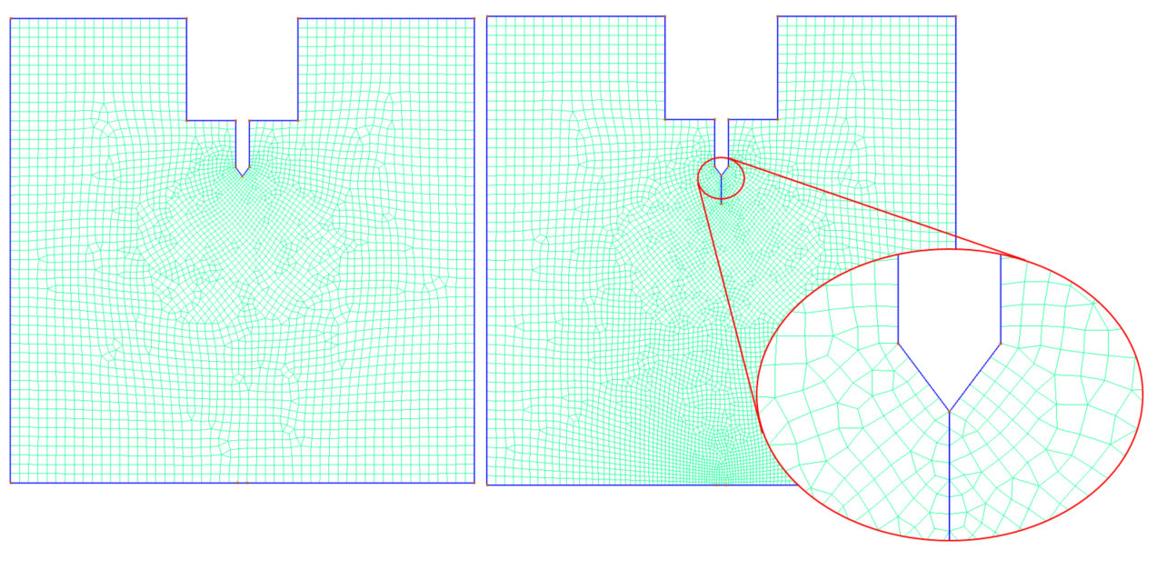
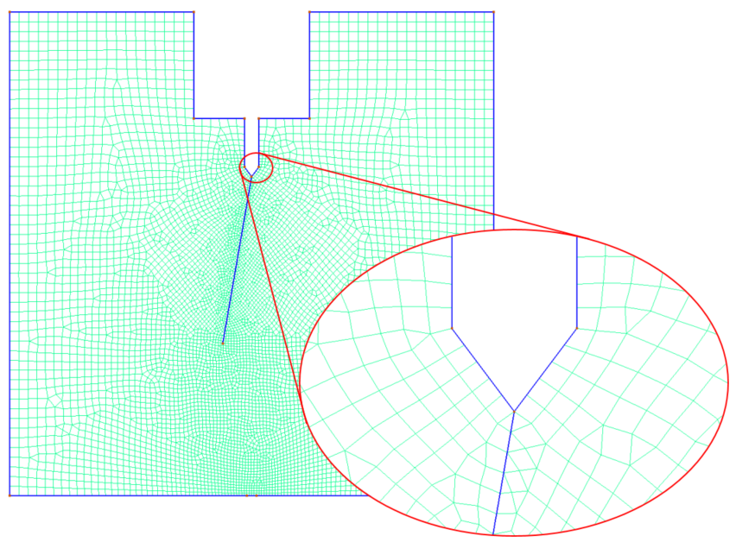
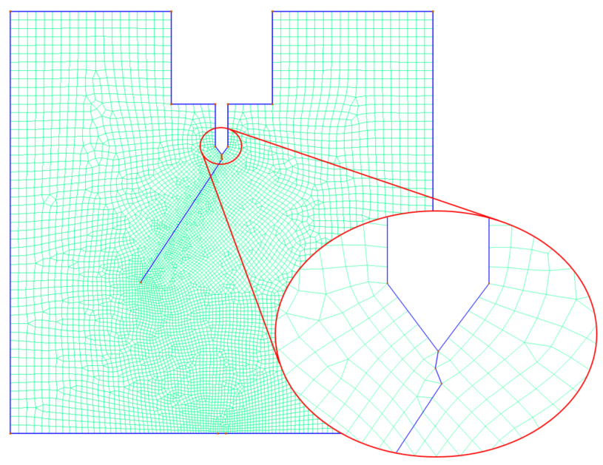
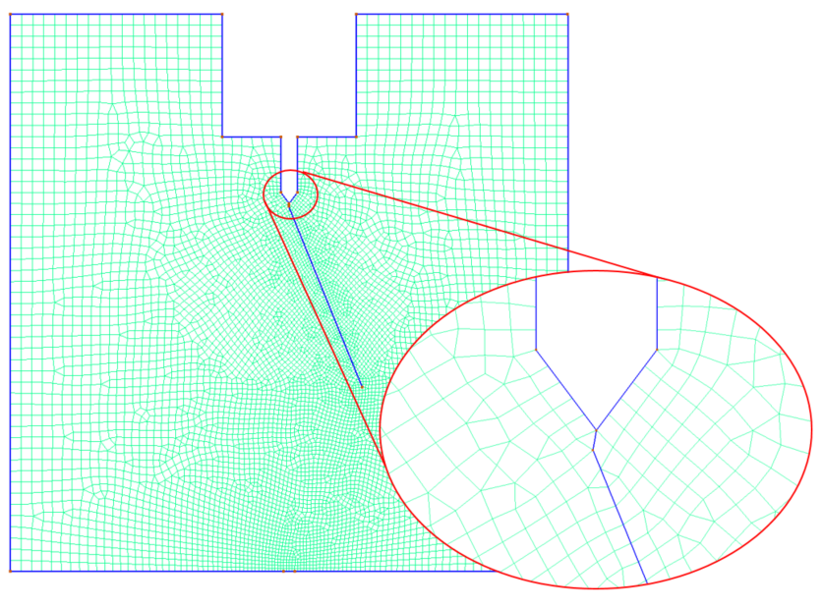
Crack path trajectory - intorduction ○○ | Traction separation law and criterion ○ | Methodlogy overview ○● | Results ○○○ | 6/10
Boundary conditions | Trajectory progression in mesh
~100 mm
~100 mm
Notes:
This slide is here to explain the problem – BC and loads - LEFT
And on RIGHT how the first few steps of propagation looks like – to correlate with slide 4 and collecting stress distribution at each iteration and how it influences the next deviation
Disclaimer – couldn't show the material properties due to confidentiality.

Slide 8
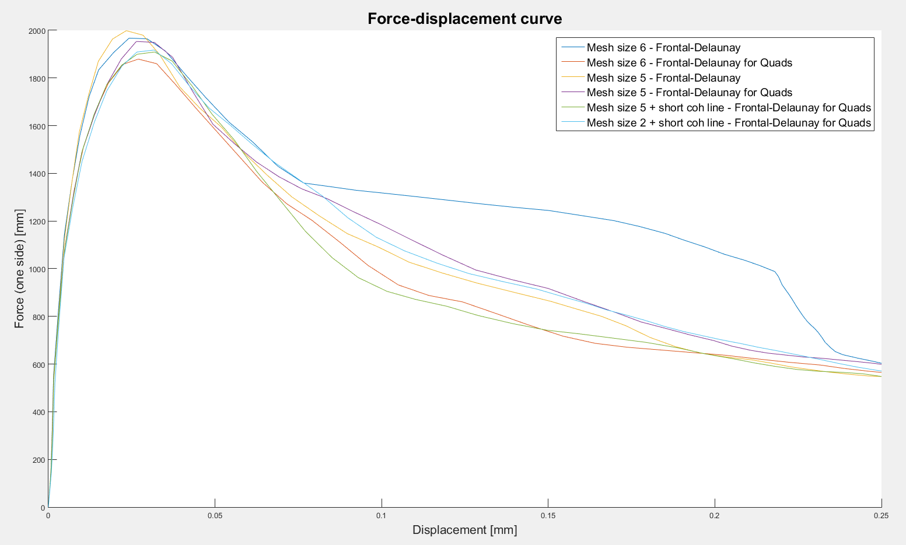
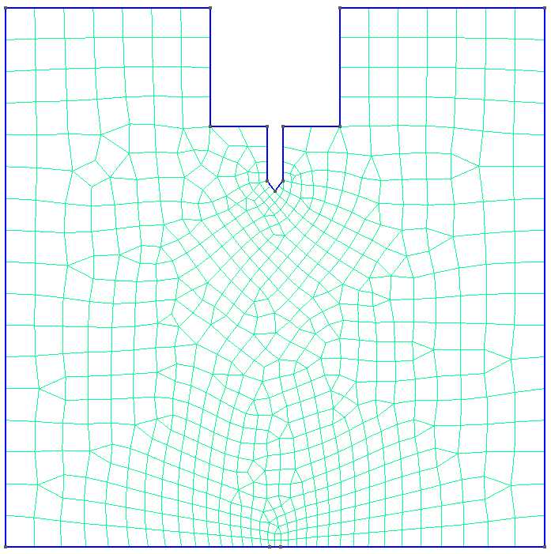
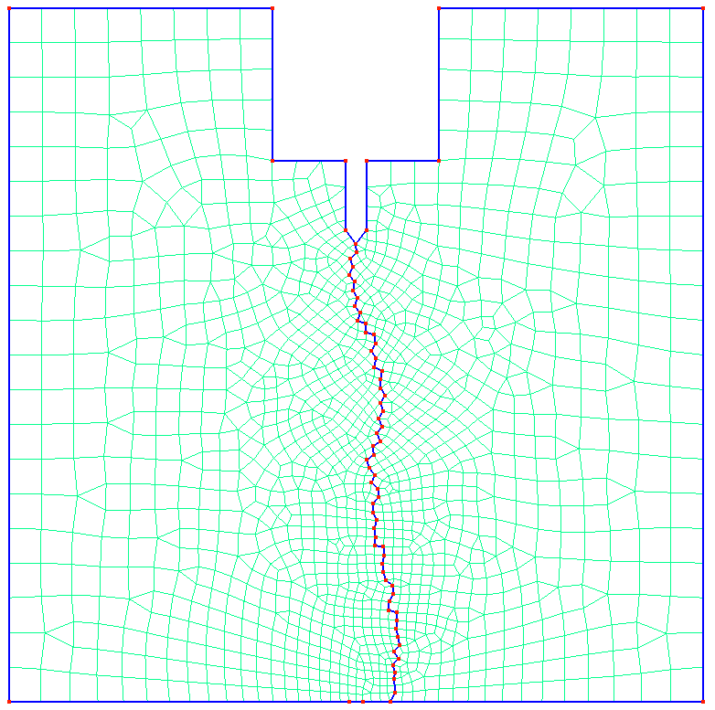
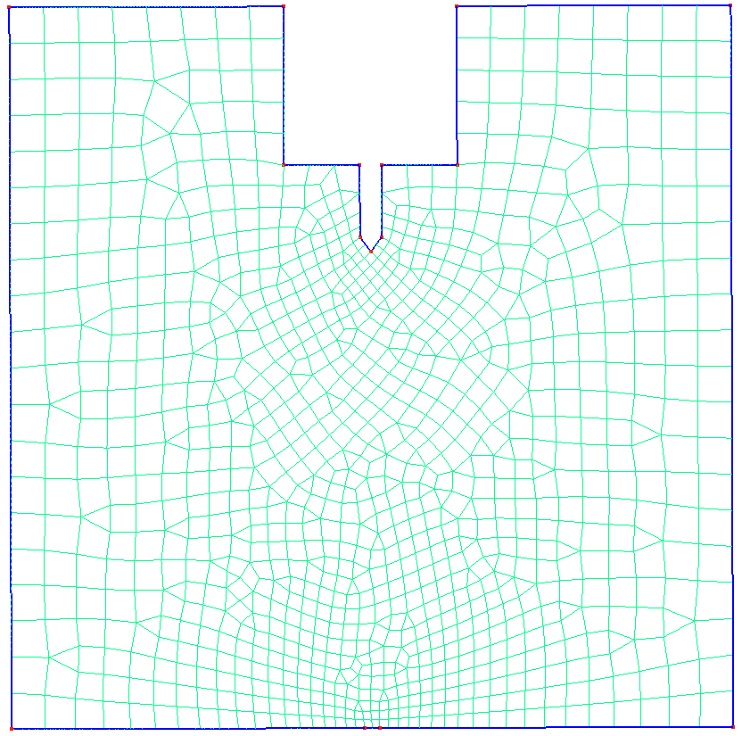
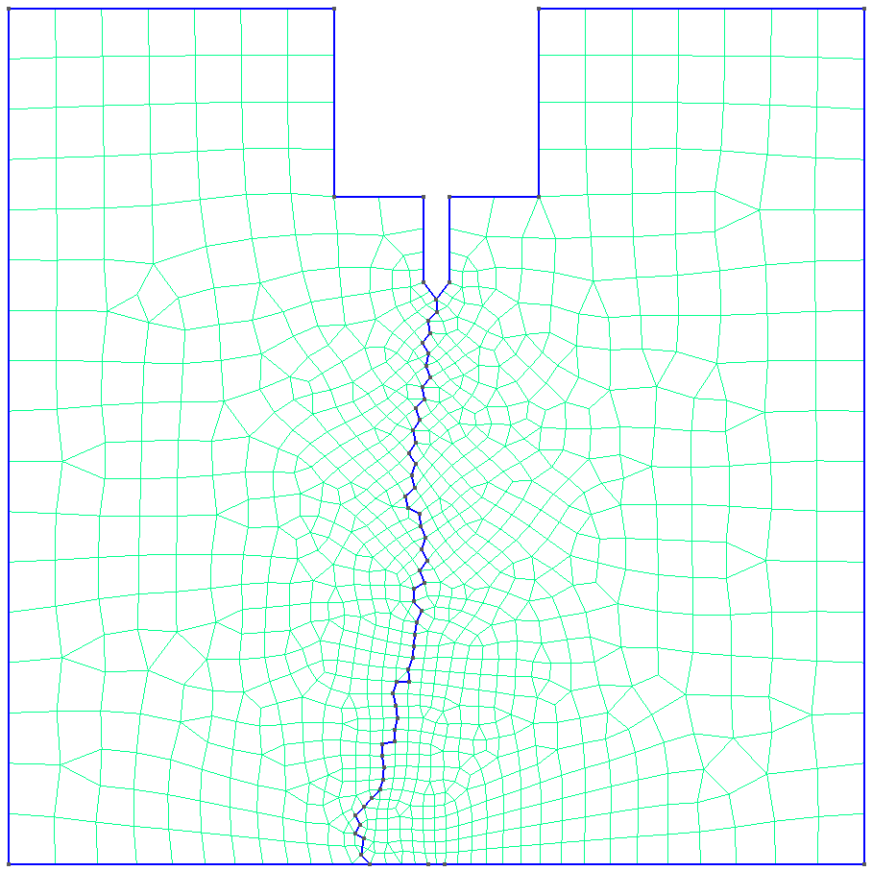
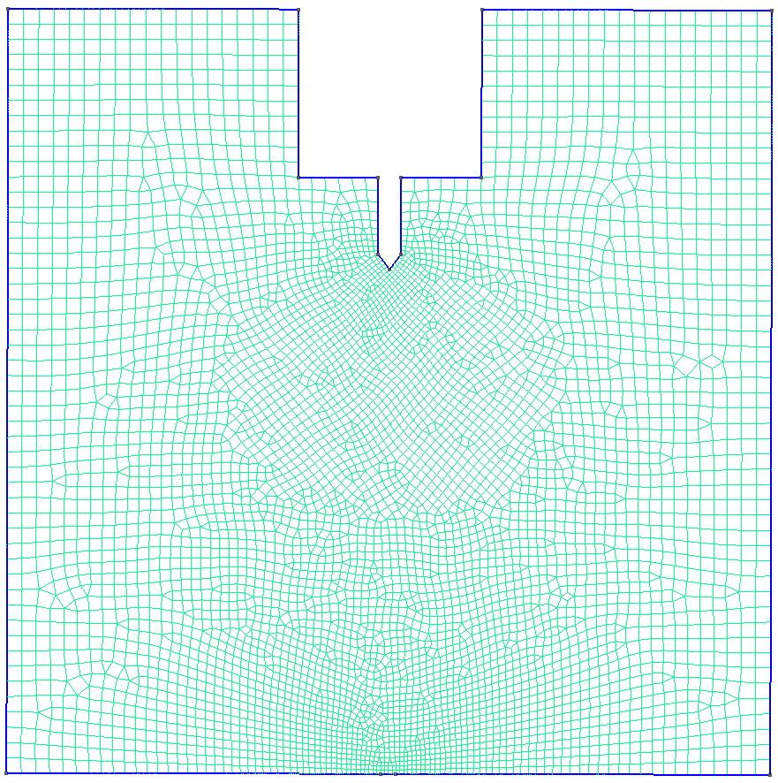
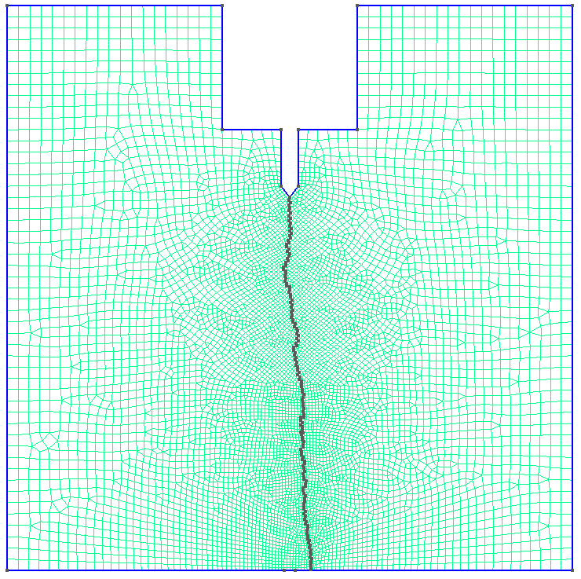
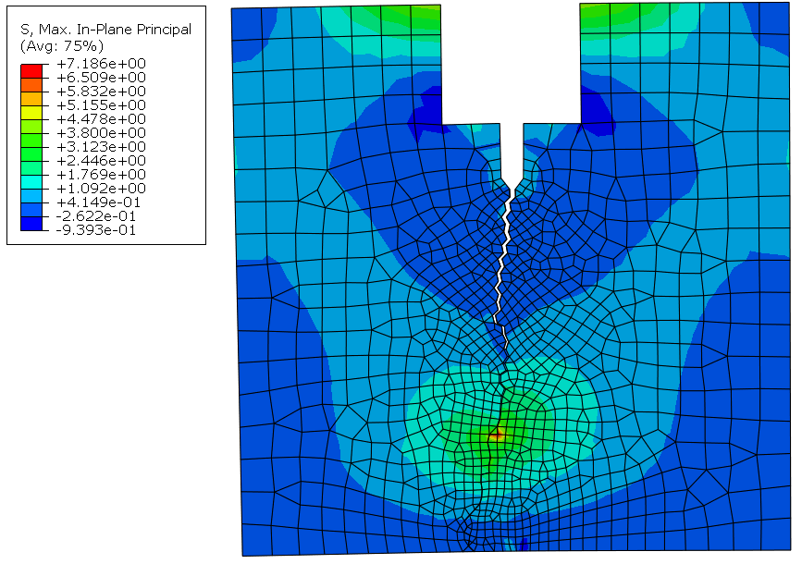
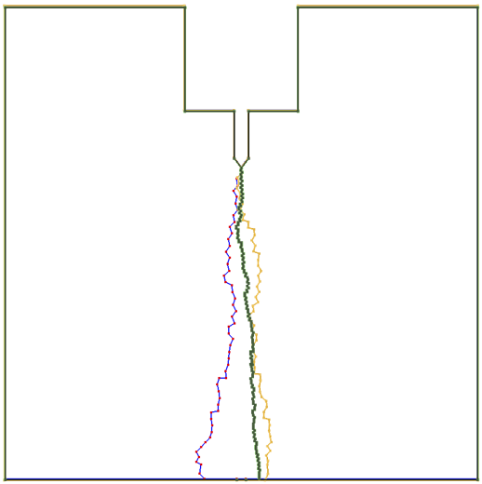
Crack path trajectory - intorduction ○○ | Traction separation law and criterion ○ | Methodlogy overview ○○ | Results ●○○ | 7/10
Example of Wedge splitting test – brittle material
Mesh – Frontal-Delaunay for Quads | 5 mm (1.25 mm)
Mesh – Frontal-Delaunay for Quads | 6 mm (1.5 mm)
Mesh – Frontal-Delaunay for Quads | 2 mm (0.5 mm)
6 mm (1.5 mm) | 5 mm (1.25 mm) | 2 mm (0.5 mm)
Notes:
This slide is here to show the results, its consistency and sensitivity analysis. Frist 3 cases are presented with mesh size 6 5 and 2 Then they are compared one to the other and overlaped to show how you cna get different paths like in real life examples. In the end Force-displacement curve is presented – arrows are comming in following order: First 3 – the presented cases
Second 2 – Mesh size 6 with different meshing techniques
Third 3 – Mesh size 5 different meshing techniques and different cohesive line length
Forth – Difference in mesh size with sorter line lenght Conclusion: Consistency is good with 1 deviation with a cours mesh size and triangular mesh - neglectable The biggest deviation is in the mid-part of the graph around 0.08-0.15 mm of displacement but all of them are finishing in almost the same spot – it would be small deviation in total fracture energy in the end.

Slide 9
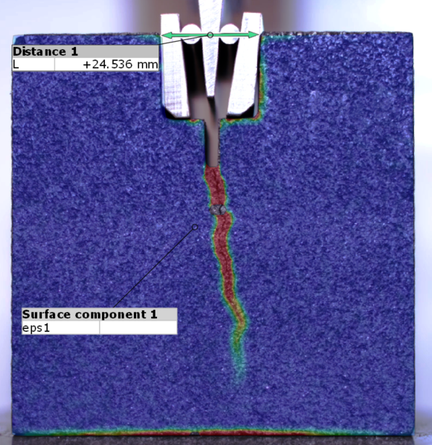
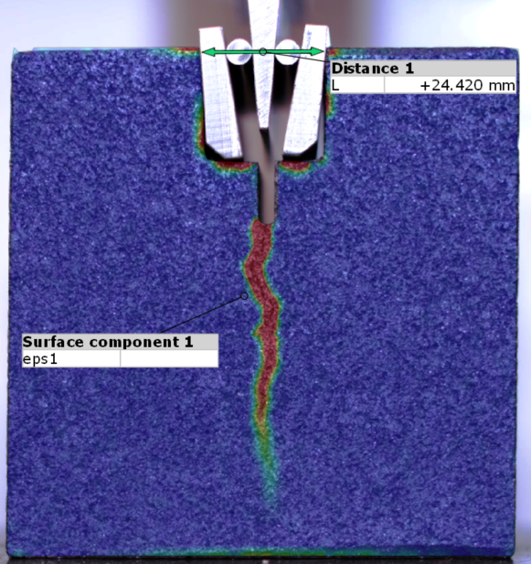
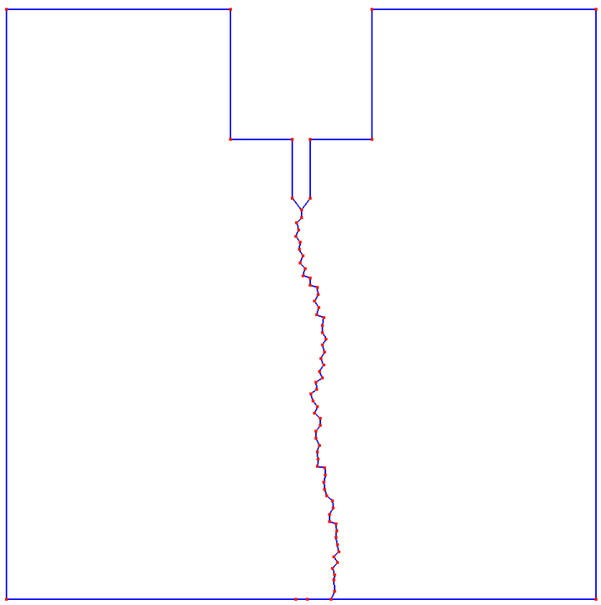
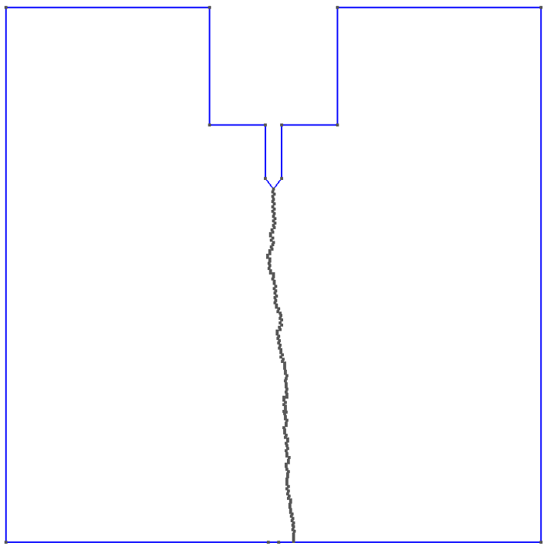
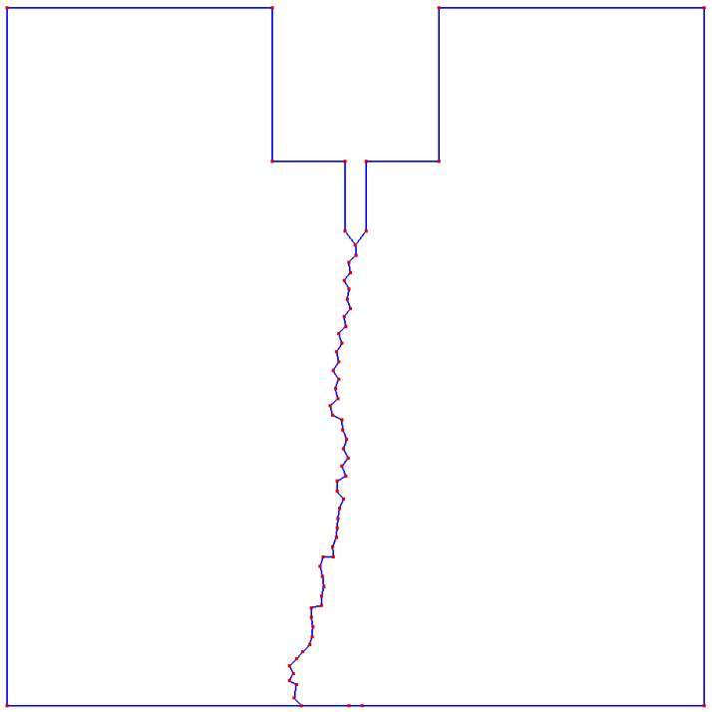
Crack path trajectory - intorduction ○○ | Traction separation law and criterion ○ | Methodlogy overview ○○ | Results ○●○ | 8/10
----$5.1 − {bulk}_{TC}−{coh}_{T}$
----$5.2 − {bulk}_{T}−{coh}_{T}$
----$5.1 − {bulk}_{TC}−{coh}_{T}$
----$5.2 − {bulk}_{T}−{coh}_{T}$
Notes:
This slide is just to present comparisson with real life crack paths

Slide 10
Crack path trajectory - intorduction ○○ | Traction separation law and criterion ○ | Methodlogy overview ○○ | Results ○○● | 9/10
Notes:
This slide is just to present comparisson with real life crack paths

Slide 11
Mathematics and Mechanics of Solids and Structures June 07-09, 2023, Aberystwyth
Thank you for your attention!
Acknowledgments to the funds received from the European Union’s Horizon 2020 research and innovation programme under the MSC grant agreement No 955944 - RE-FRACTURE2.
Domagoj Uremović
duremovic@mas.br.ac.rs
This project has received funding from the European Union’s Horizon 2020 research and innovation programme under the Marie Sklodowska-Curie grant agreement No 955944 - RE-FRACTURE2.

Slide 12
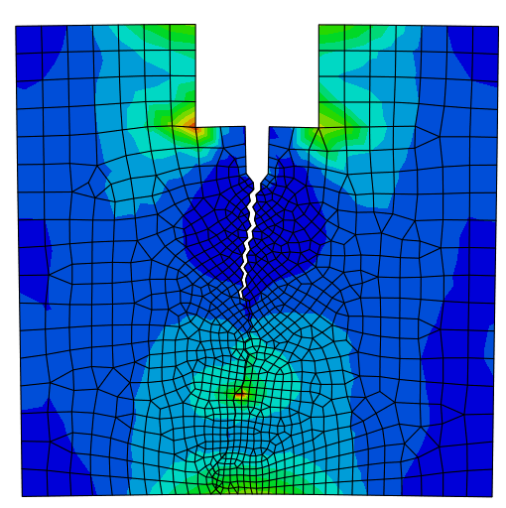
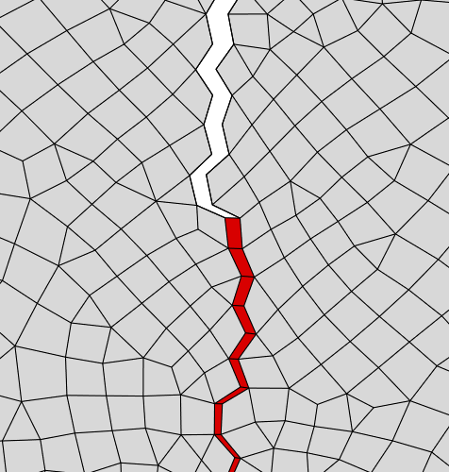

Slide 13
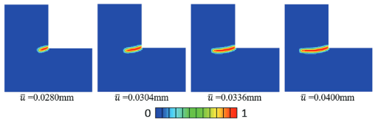
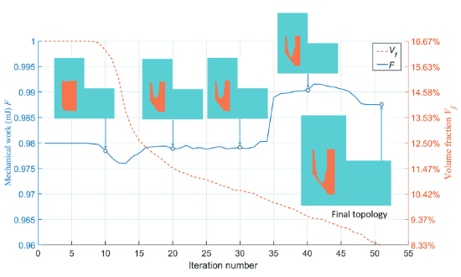
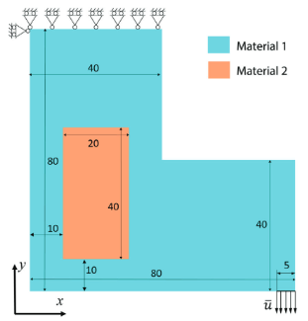
Level-set topology optimization for maximizing fracture resistance of brittle materials using phase-field fracture model Chi Wu; Jianguang Fang; Shiwei Zhou; Zhongpu Zhang; Guangyong Sun; Grant P. Steven; Qing Li | University of Sydney & Melbourne International Journal for Numerical Methods in Engineering 2020;121:2929–2945.
8
Crack propagation in homogeneous material:
Main ingredients:
level-set (LS) based topology optimization
phase-field fracture model
Multi material
Initial conditions:
Simulation parameters:
Displacement control
Porcelain (matrix) and zirconia
E1=69GPa | E2=210GPa
Design objective:
Maximize the fracture resistence with no more then 1/12 (8.33% of whole section) reinforced material
Crack initialization and propagation captured

Slide 14
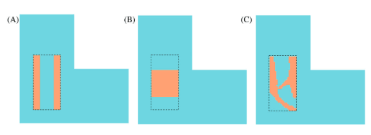
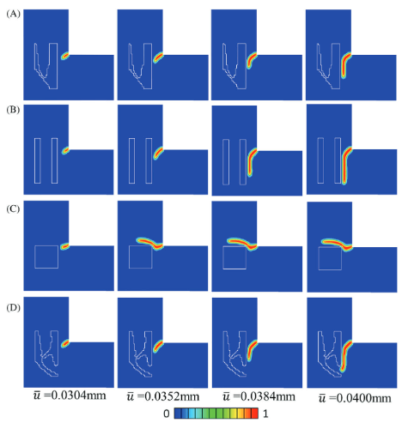
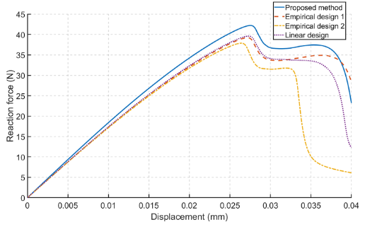
9
Case study comparison:
A) Empirical design 1, B) Empirical design 2, C) Stiffness-driven TO
Crack propagation is such cases:
Force – displacement curve comparison:

